Slide 1
Chapter 23
Distributed DBMSs - Advanced Concepts
Transparencies
Notes:
Chapter Name
September 98

Slide 2
Chapter 23 - Objectives
Distributed transaction management.
Distributed concurrency control.
Distributed deadlock detection.
Distributed recovery control.
Distributed integrity control.
X/OPEN DTP standard.
Replication servers.
Distributed query optimization.

Slide 3
Distributed Transaction Management
Distributed transaction accesses data stored at more than one location.
Divided into a number of sub-transactions, one for each site that has to be accessed, represented by an agent.
Indivisibility of distributed transaction is still fundamental to transaction concept.
DDBMS must also ensure indivisibility of each sub-transaction.

Slide 4
Distributed Transaction Management
Thus, DDBMS must ensure:
  synchronization of subtransactions with other local transactions executing concurrently at a site;
  synchronization of subtransactions with global transactions running simultaneously at same or different sites.
Global transaction manager (transaction coordinator) at each site, to coordinate global and local transactions initiated at that site.

Slide 5
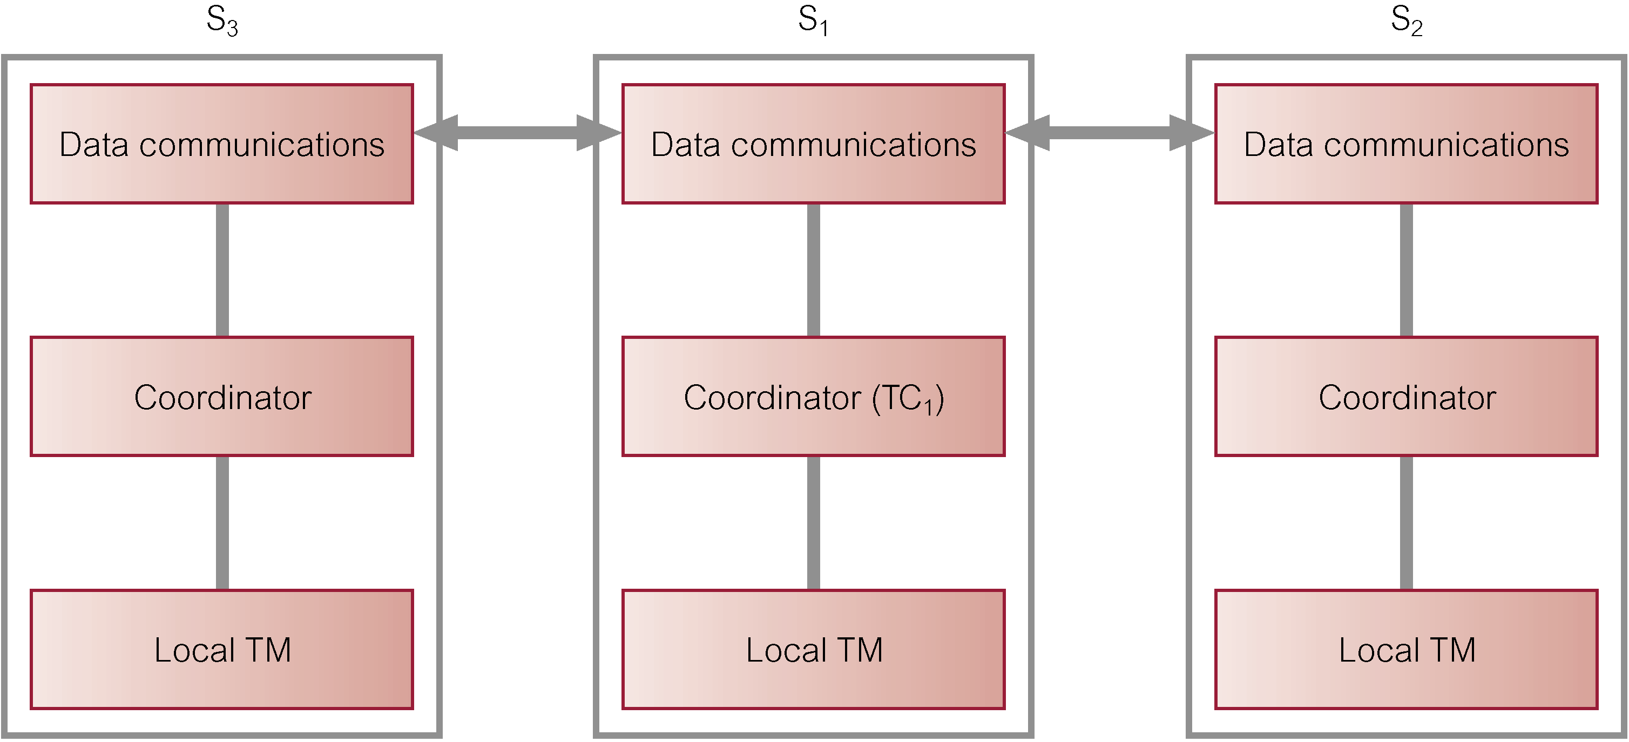
Coordination of Distributed Transaction

Slide 6
Distributed Locking
Look at four schemes:
  Centralized Locking.
  Primary Copy 2PL.
  Distributed 2PL.
  Majority Locking.

Slide 7
Centralized Locking
Single site that maintains all locking information.
One lock manager for whole of DDBMS.
Local transaction managers involved in global transaction request and release locks from lock manager.
Or transaction coordinator can make all locking requests on behalf of local transaction managers.
Advantage - easy to implement.
Disadvantages - bottlenecks and lower reliability.

Slide 8
Primary Copy 2PL
Lock managers distributed to a number of sites.
Each lock manager responsible for managing locks for set of data items.
For replicated data item, one copy is chosen as primary copy, others are slave copies
Only need to write-lock primary copy of data item that is to be updated.
Once primary copy has been updated, change can be propagated to slaves.

Slide 9
Primary Copy 2PL
Disadvantages - deadlock handling is more complex; still a degree of centralization in system.
Advantages - lower communication costs and better performance than centralized 2PL.

Slide 10
Distributed 2PL
Lock managers distributed to every site.
Each lock manager responsible for locks for data at that site.
If data not replicated, equivalent to primary copy 2PL.
Otherwise, implements a Read-One-Write-All (ROWA) replica control protocol.

Slide 11
Distributed 2PL
Using ROWA protocol:
  Any copy of replicated item can be used for read.
  All copies must be write-locked before item can be updated.
Disadvantages - deadlock handling more complex; communication costs higher than primary copy 2PL.

Slide 12
Majority Locking
Extension of distributed 2PL.
To read or write data item replicated at n sites, sends a lock request to more than half the n sites where item is stored.
Transaction cannot proceed until majority of locks obtained.
Overly strong in case of read locks.

Slide 13
Distributed Timestamping
Objective is to order transactions globally so older transactions (smaller timestamps) get priority in event of conflict.
In distributed environment, need to generate unique timestamps both locally and globally.
System clock or incremental event counter at each site is unsuitable.
Concatenate local timestamp with a unique site identifier: <local timestamp, site identifier>.

Slide 14
Distributed Timestamping
Site identifier placed in least significant position to ensure events ordered according to their occurrence as opposed to their location.
To prevent a busy site generating larger timestamps than slower sites:
  Each site includes their timestamps in messages.
  Site compares its timestamp with timestamp in message and, if its timestamp is smaller, sets it to some value greater than message timestamp.

Slide 15
Distributed Deadlock
More complicated if lock management is not centralized.
Local Wait-for-Graph (LWFG) may not show existence of deadlock.
May need to create GWFG, union of all LWFGs.
Look at three schemes:
  Centralized Deadlock Detection.
  Hierarchical Deadlock Detection.
  Distributed Deadlock Detection.

Slide 16
Example - Distributed Deadlock
T₁ initiated at site S₁ and creating agent at S₂,
T₂ initiated at site S₂ and creating agent at S₃,
T₃ initiated at site S₃ and creating agent at S₁.
Time S₁ S₂ S₃
t₁ read_lock(T₁, x₁) write_lock(T₂, y₂) read_lock(T₃, z₃)
t₂ write_lock(T₁, y₁) write_lock(T₂, z₂)
t₃ write_lock(T₃, x₁) write_lock(T₁, y₂) write_lock(T₂, z₃)

Slide 17
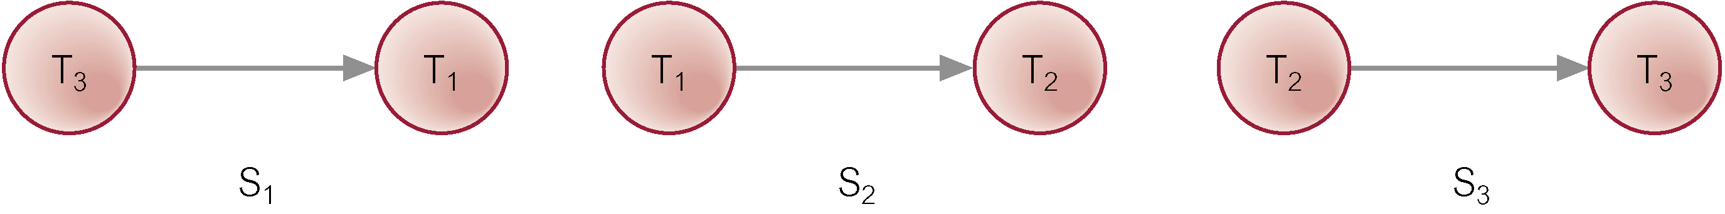
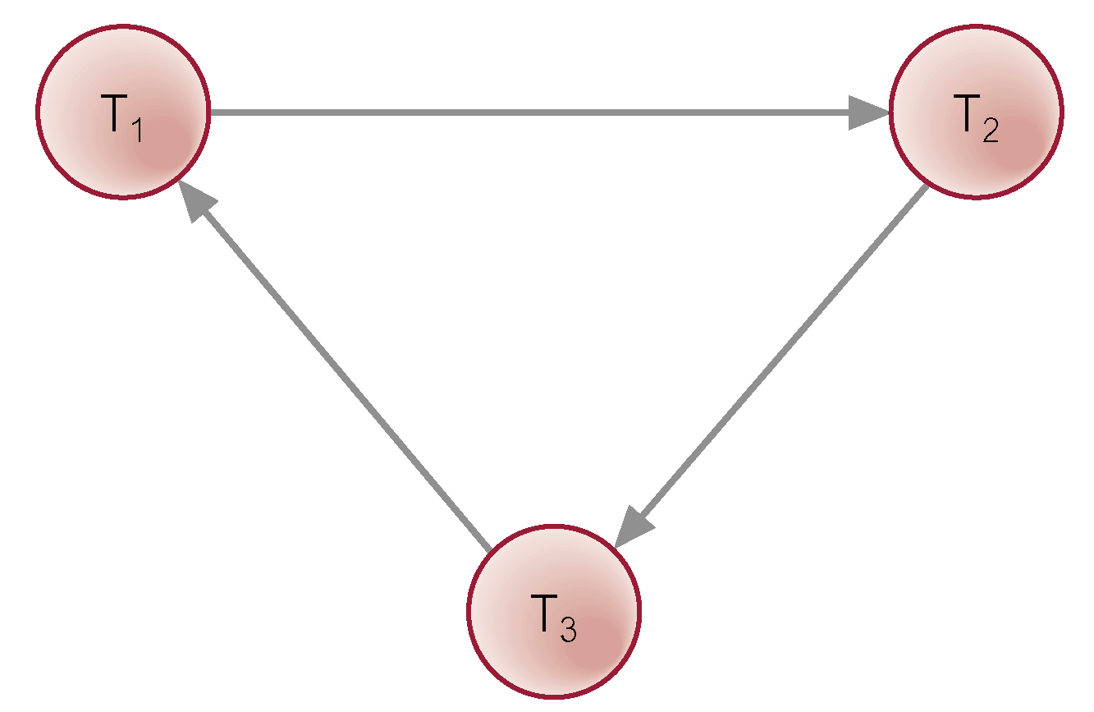
Example - Distributed Deadlock

Slide 18
Centralized Deadlock Detection
Single site appointed deadlock detection coordinator (DDC).
DDC has responsibility for constructing and maintaining GWFG.
If one or more cycles exist, DDC must break each cycle by selecting transactions to be rolled back and restarted.

Slide 19
Hierarchical Deadlock Detection
Sites are organized into a hierarchy.
Each site sends its LWFG to detection site above it in hierarchy.
Reduces dependence on centralized detection site.

Slide 20
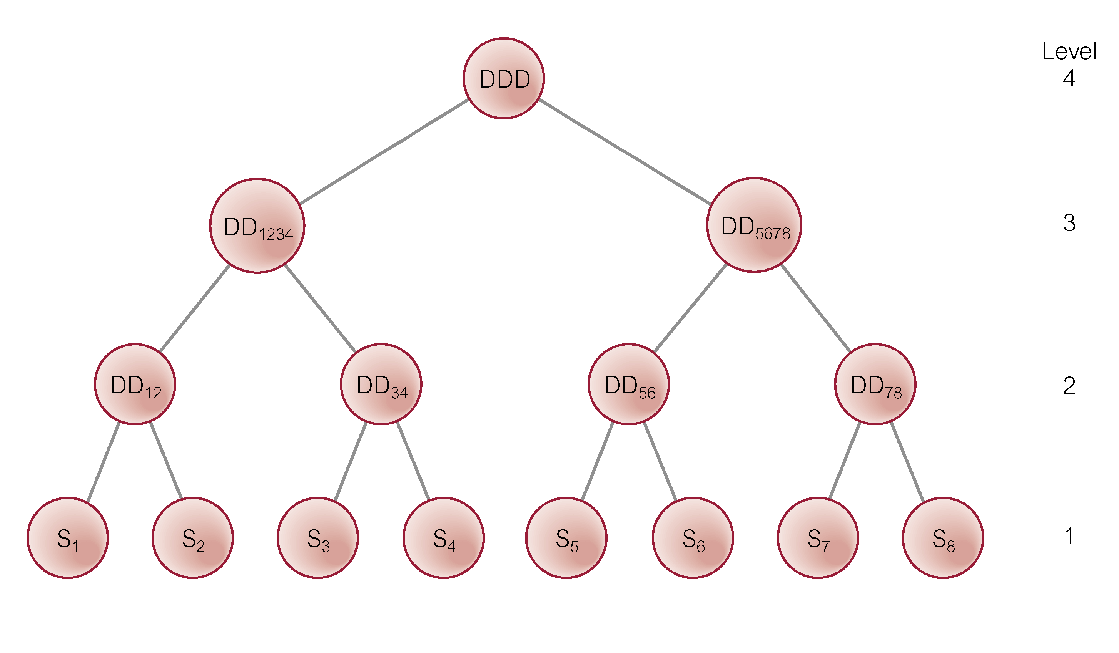
Hierarchical Deadlock Detection

Slide 21
Distributed Deadlock Detection
Most well-known method developed by Obermarck (1982).
An external node, T_{ext}, is added to LWFG to indicate remote agent.
If a LWFG contains a cycle that does not involve T_{ext}, then site and DDBMS are in deadlock.

Slide 22
Distributed Deadlock Detection
Global deadlock may exist if LWFG contains a cycle involving T_{ext}.
To determine if there is deadlock, the graphs have to be merged.
Potentially more robust than other methods.

Slide 23
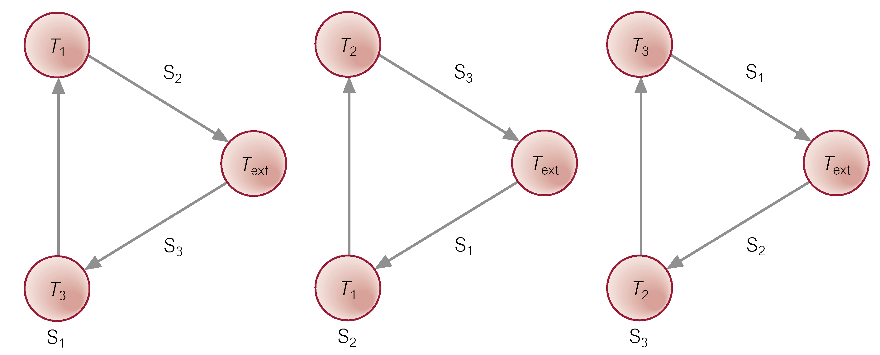
Distributed Deadlock Detection

Slide 24
Distributed Deadlock Detection
  S₁: T_{ext} → T₃ → T₁ → T_{ext}
  S₂: T_{ext} → T₁ → T₂ → T_{ext}
  S₃: T_{ext} → T₂ → T₃ → T_{ext}
Transmit LWFG for S₁ to the site for which transaction T₁ is waiting, site S₂.
LWFG at S₂ is extended and becomes:
  S₂: T_{ext} → T₃ → T₁ → T₂ → T_{ext}

Slide 25
Distributed Deadlock Detection
Still contains potential deadlock, so transmit this WFG to S₃:
  S₃: T_{ext} → T₃ → T₁ → T₂ → T₃ → T_{ext}
GWFG contains cycle not involving T_{ext}, so deadlock exists.

Slide 26
Distributed Deadlock Detection
Four types of failure particular to distributed systems:
  Loss of a message.
  Failure of a communication link.
  Failure of a site.
  Network partitioning.
Assume first are handled transparently by DC component.

Slide 27
Distributed Recovery Control
DDBMS is highly dependent on ability of all sites to be able to communicate reliably with one another.
Communication failures can result in network becoming split into two or more partitions.
May be difficult to distinguish whether communication link or site has failed.

Slide 28
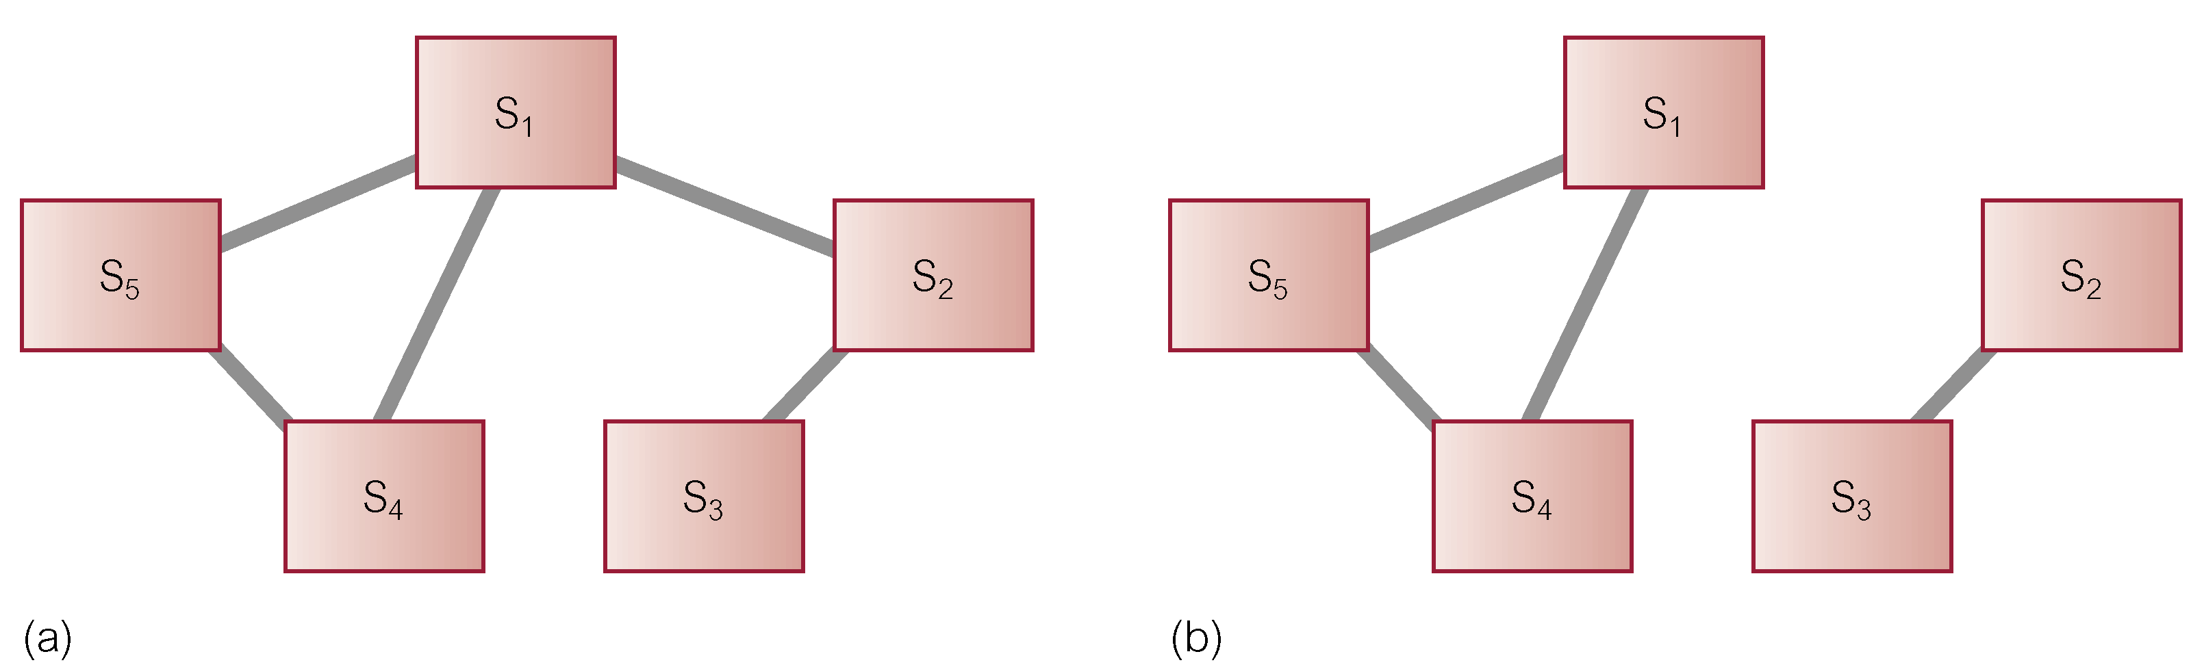
Partitioning of a network

Slide 29
Two-Phase Commit (2PC)
Two phases: a voting phase and a decision phase.
Coordinator asks all participants whether they are prepared to commit transaction.
  If one participant votes abort, or fails to respond within a timeout period, coordinator instructs all participants to abort transaction.
  If all vote commit, coordinator instructs all participants to commit.
All participants must adopt global decision.

Slide 30
Two-Phase Commit (2PC)
If participant votes abort, free to abort transaction immediately
If participant votes commit, must wait for coordinator to broadcast global-commit or global-abort message.
Protocol assumes each site has its own local log and can rollback or commit transaction reliably.
If participant fails to vote, abort is assumed.
If participant gets no vote instruction from coordinator, can abort.

Slide 31
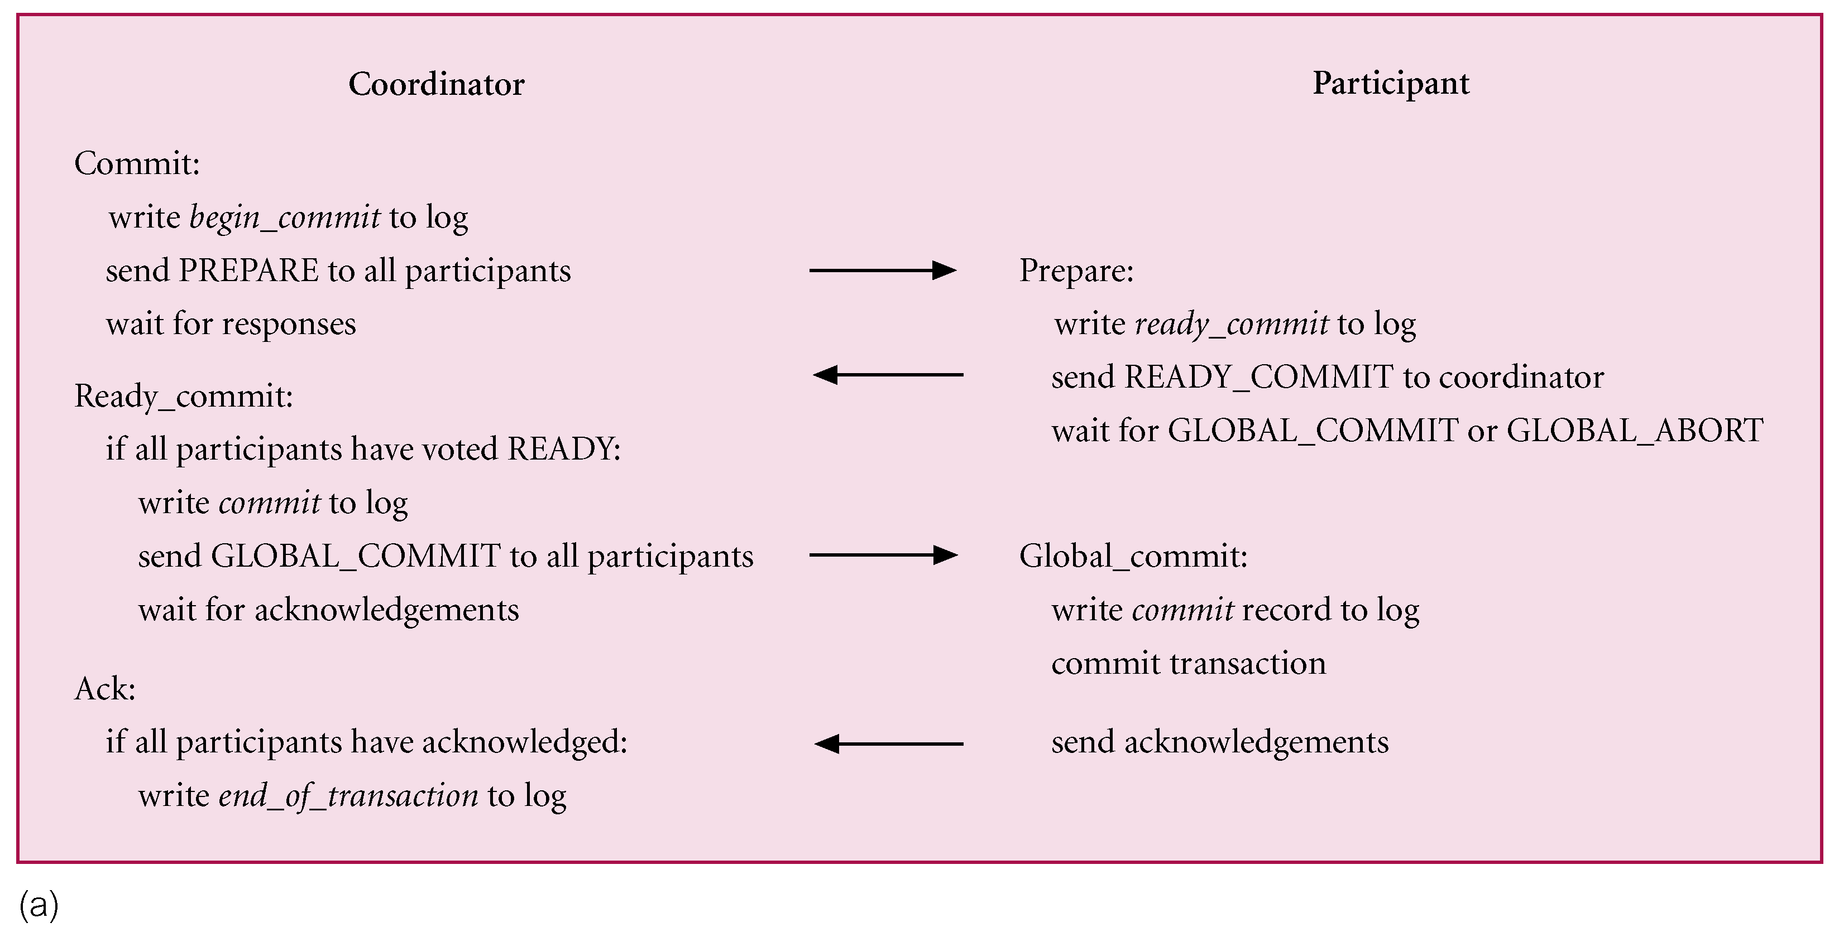
2PC Protocol for Participant Voting Commit

Slide 32
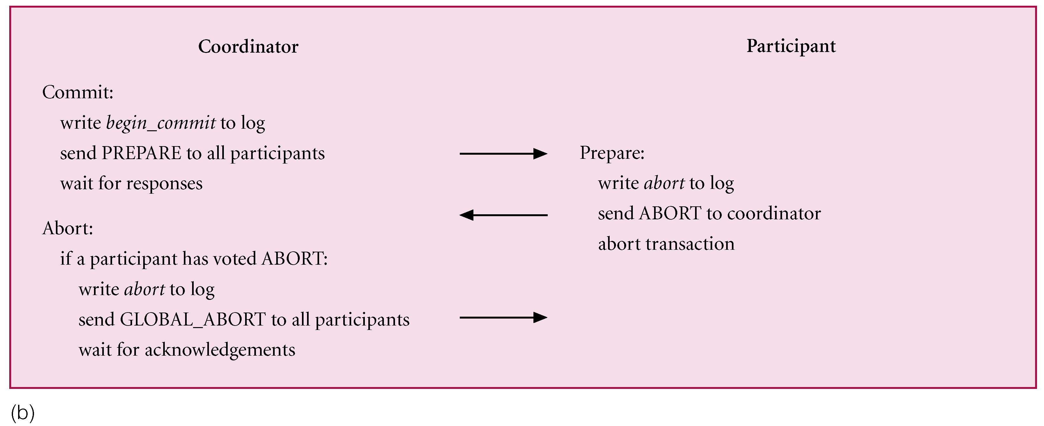
2PC Protocol for Participant Voting Abort

Slide 33
Termination Protocols
Invoked whenever a coordinator or participant fails to receive an expected message and times out.
Coordinator
Timeout in WAITING state
  Globally abort the transaction.
Timeout in DECIDED state
  Send global decision again to sites that have not acknowledged.

Slide 34
Termination Protocols - Participant
Simplest termination protocol is to leave participant blocked until communication with the coordinator is re-established. Alternatively:
Timeout in INITIAL state
  Unilaterally abort the transaction.
Timeout in the PREPARED state
  Without more information, participant blocked.
  Could get decision from another participant .

Slide 35
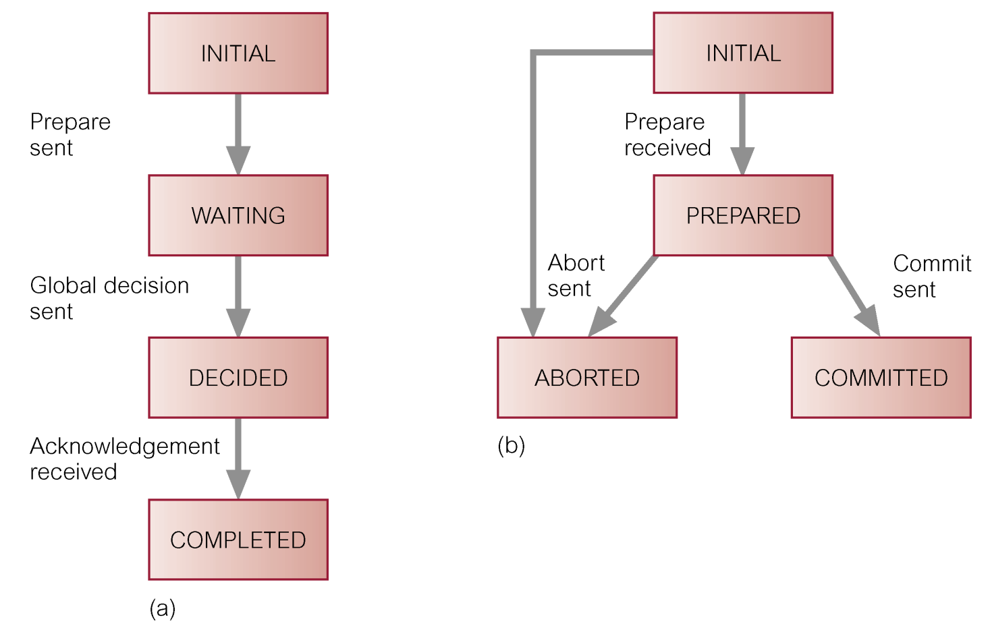
State Transition Diagram for 2PC
(a) coordinator; (b) participant

Slide 36
Recovery Protocols
Action to be taken by operational site in event of failure. Depends on what stage coordinator or participant had reached.
Coordinator Failure
Failure in INITIAL state
  Recovery starts the commit procedure.
Failure in WAITING state
  Recovery restarts the commit procedure.

Slide 37
2PC - Coordinator Failure
Failure in DECIDED state
  On restart, if coordinator has received all acknowledgements, it can complete successfully. Otherwise, has to initiate termination protocol discussed above.

Slide 38
2PC - Participant Failure
Objective to ensure that participant on restart performs same action as all other participants and that this restart can be performed independently.
Failure in INITIAL state
  Unilaterally abort the transaction.
Failure in PREPARED state
  Recovery via termination protocol above.
Failure in ABORTED/COMMITTED states
  On restart, no further action is necessary.

Slide 39
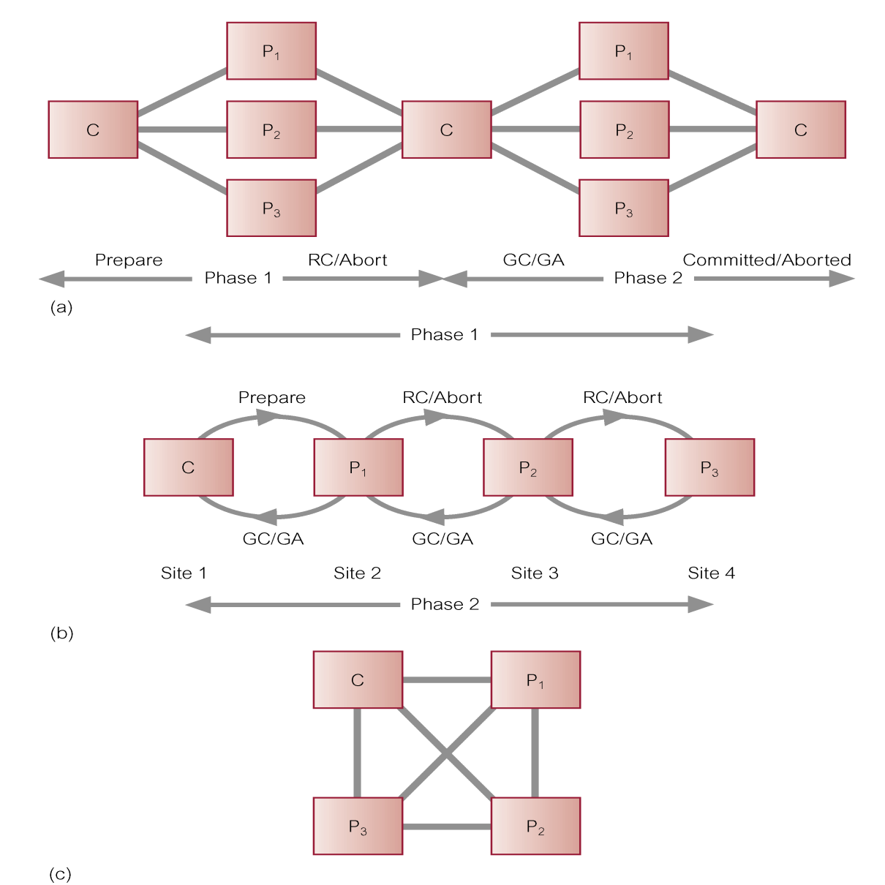
2PC Topologies

Slide 40
Three-Phase Commit (3PC)
2PC is not a non-blocking protocol.
For example, a process that times out after voting commit, but before receiving global instruction, is blocked if it can communicate only with sites that do not know global decision.
Probability of blocking occurring in practice is sufficiently rare that most existing systems use 2PC.

Slide 41
Three-Phase Commit (3PC)
Alternative non-blocking protocol, called three-phase commit (3PC) protocol.
Non-blocking for site failures, except in event of failure of all sites.
Communication failures can result in different sites reaching different decisions, thereby violating atomicity of global transactions.
3PC removes uncertainty period for participants who have voted commit and await global decision.

Slide 42
Three-Phase Commit (3PC)
Introduces third phase, called pre-commit, between voting and global decision.
On receiving all votes from participants, coordinator sends global pre-commit message.
Participant who receives global pre-commit, knows all other participants have voted commit and that, in time, participant itself will definitely commit.

Slide 43
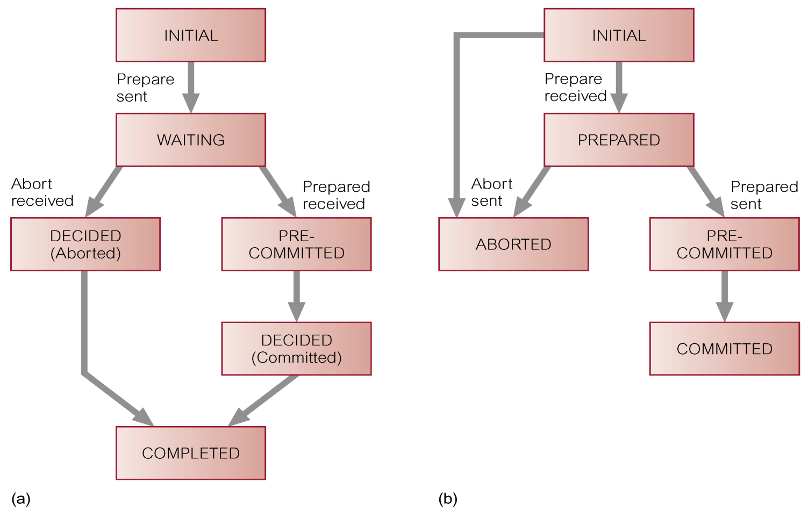
State Transition Diagram for 3PC
(a) coordinator; (b) participant

Slide 44
Network Partitioning
If data is not replicated, can allow transaction to proceed if it does not require any data from site outside partition in which it is initiated.
Otherwise, transaction must wait until sites it needs access to are available.
If data is replicated, procedure is much more complicated.

Slide 45
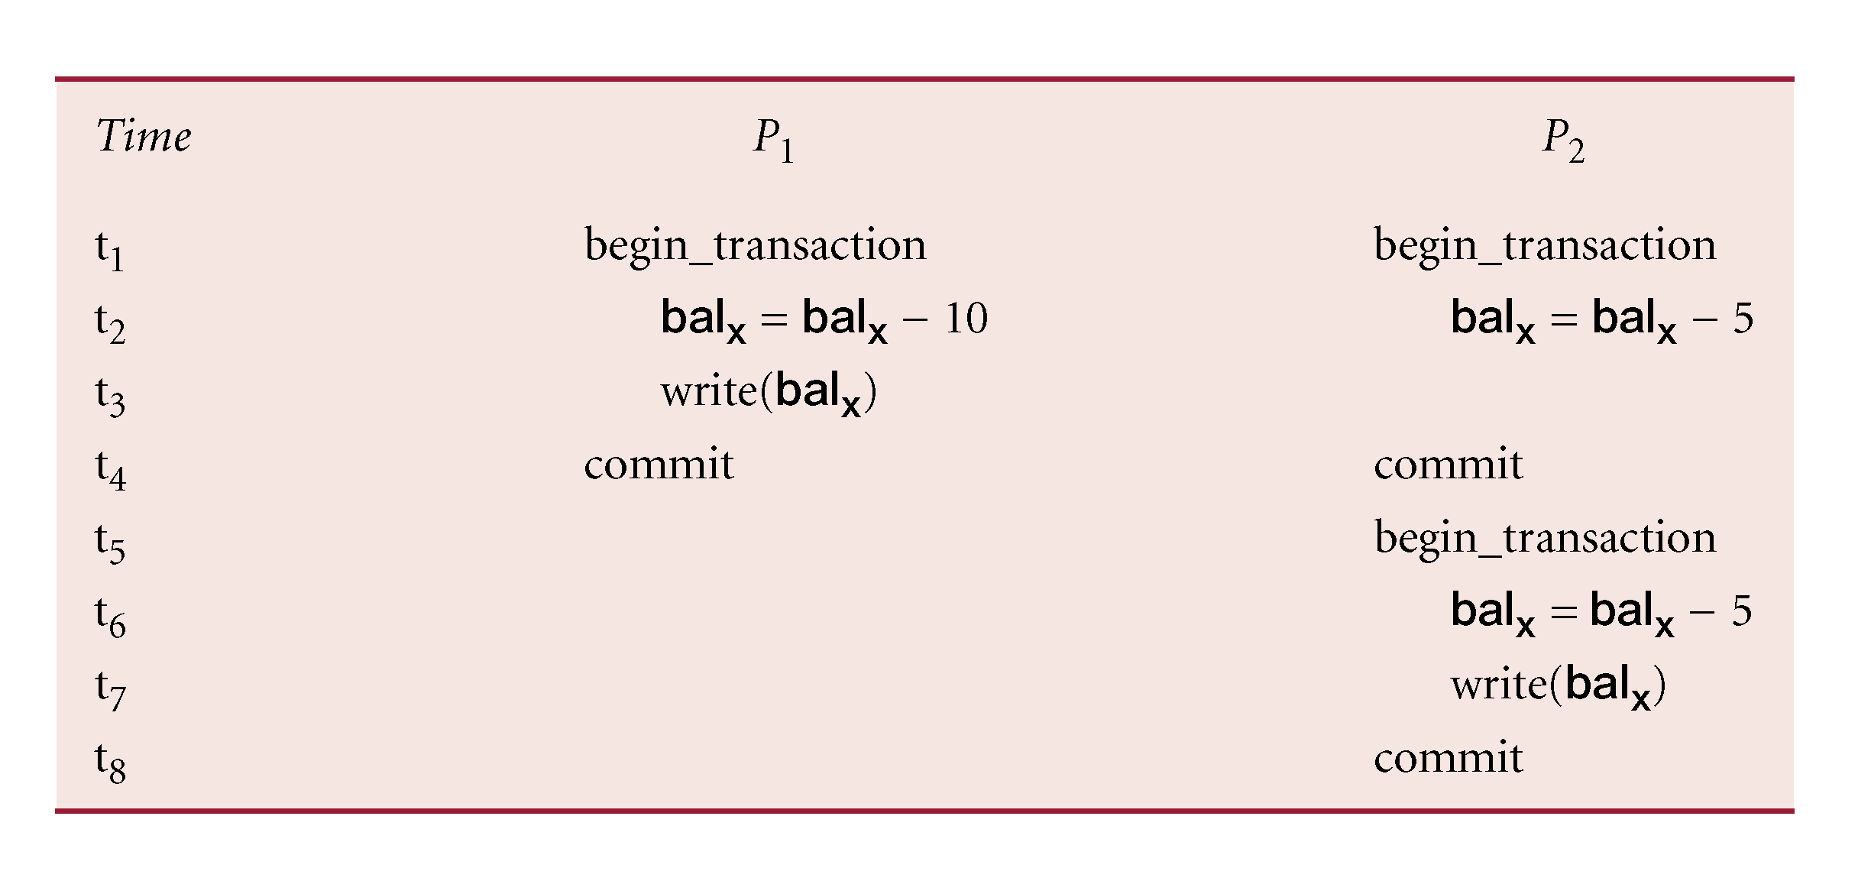
Identifying Updates

Slide 46
Identifying Updates
Successfully completed update operations by users in different partitions can be difficult to observe.
In P₁, transaction withdrawn £10 from account and in P₂, two transactions have each withdrawn £5 from same account.
At start, both partitions have £100 in bal_{x}, and on completion both have £90 in bal_{x}.
On recovery, not sufficient to check value in bal_{x} and assume consistency if values same.

Slide 47
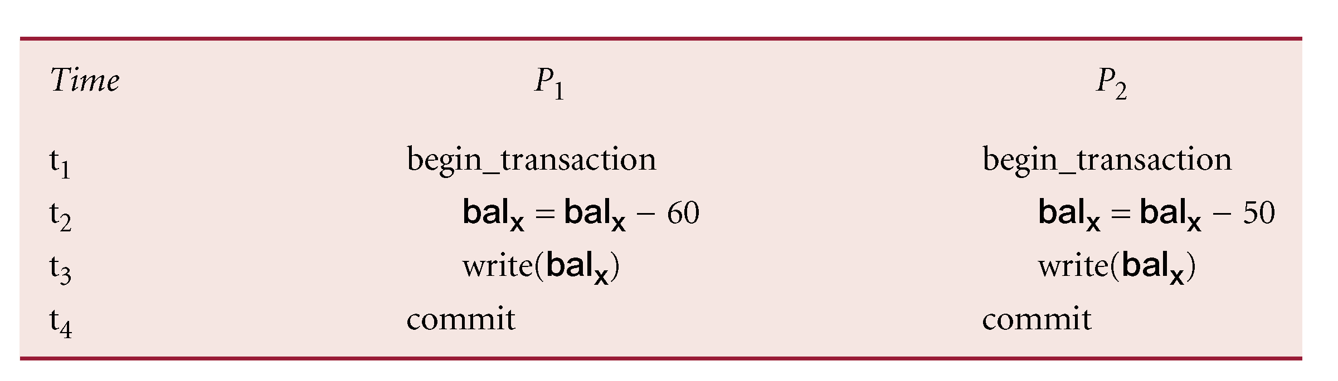
Maintaining Integrity

Slide 48
Maintaining Integrity
Successfully completed update operations by users in different partitions can violate constraints.
Have constraint that account cannot go below £0.
In P₁, withdrawn £60 from account and in P₂, withdrawn £50.
At start, both partitions have £100 in bal_{x}, then on completion one has £40 in bal_{x} and other has £50.
Importantly, neither has violated constraint.
On recovery, bal_{x} is –£10, and constraint violated.

Slide 49
Network Partitioning
Processing in partitioned network involves trade-off in availability and correctness.
Correctness easiest to provide if no processing of replicated data allowed during partitioning.
Availability maximized if no restrictions placed on processing of replicated data.
In general, not possible to design non-blocking commit protocol for arbitrarily partitioned networks.

Slide 50
X/OPEN DTP Model
Open Group is vendor-neutral consortium whose mission is to cause creation of viable, global information infrastructure.
Formed by merge of X/Open and Open Software Foundation.
X/Open established DTP Working Group with objective of specifying and fostering appropriate APIs for TP.
Group concentrated on elements of TP system that provided the ACID properties.

Slide 51
X/OPEN DTP Model
X/Open DTP standard that emerged specified three interacting components:
  an application,
  a transaction manager (TM),
  a resource manager (RM).

Slide 52
X/OPEN DTP Model
Any subsystem that implements transactional data can be a RM, such as DBMS, transactional file system or session manager.
TM responsible for defining scope of transaction, and for assigning unique ID to it.
Application calls TM to start transaction, calls RMs to manipulate data, and calls TM to terminate transaction.
TM communicates with RMs to coordinate transaction, and TMs to coordinate distributed transactions.

Slide 53
X/OPEN DTP Model - Interfaces
Application may use TX interface to communicate with a TM.
TX provides calls that define transaction scope, and whether to commit/abort transaction.
TM communicates transactional information with RMs through XA interface.
Finally, application can communicate directly with RMs through a native API, such as SQL or ISAM.

Slide 54
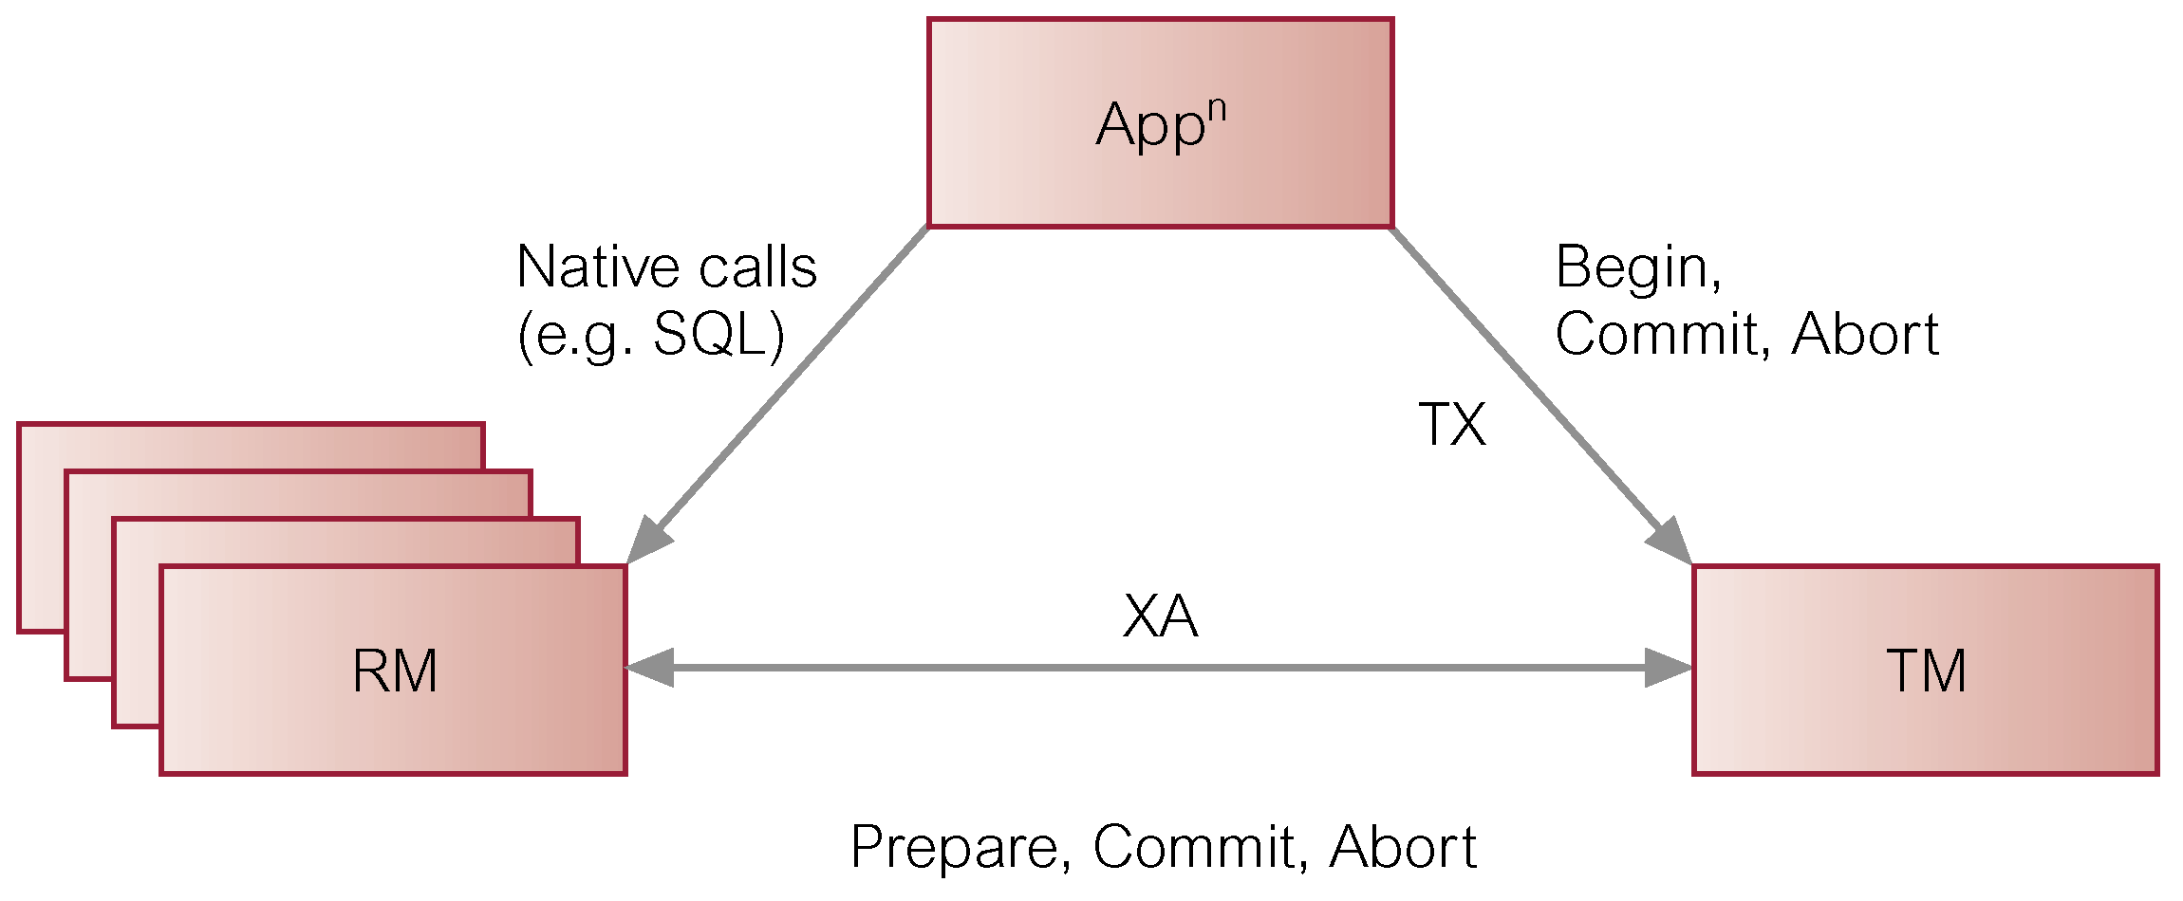
X/OPEN DTP Model Interfaces

Slide 55
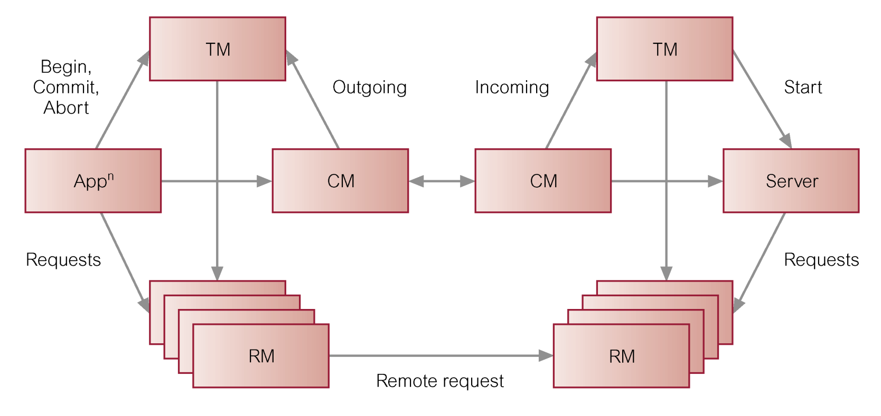
X/OPEN Interfaces in Distributed Environment

Slide 56
Replication Servers
Currently some prototype and special-purpose DDBMSs, and many of the protocols and problems are well understood.
However, to date, general purpose DDBMSs have not been widely accepted.
Instead, database replication, the copying and maintenance of data on multiple servers, may be more preferred solution.
Every major database vendor has replication solution.

Slide 57
Synchronous versus Asynchronous Replication
Synchronous – updates to replicated data are part of enclosing transaction.
  If one or more sites that hold replicas are unavailable transaction cannot complete.
  Large number of messages required to coordinate synchronization.
Asynchronous - target database updated after source database modified.
Delay in regaining consistency may range from few seconds to several hours or even days.

Slide 58
Functionality
At basic level, has to be able to copy data from one database to another (synch. or asynch.).
Other functions include:
  Scalability.
  Mapping and Transformation.
  Object Replication.
  Specification of Replication Schema.
  Subscription mechanism.
  Initialization mechanism.

Slide 59
Data Ownership
Ownership relates to which site has privilege to update the data.
Main types of ownership are:
  Master/slave (or asymmetric replication),
  Workflow,
  Update-anywhere (or peer-to-peer or symmetric replication).

Slide 60
Master/Slave Ownership
Asynchronously replicated data is owned by one (master) site, and can be updated by only that site.
Using ‘publish-and-subscribe’ metaphor, master site makes data available.
Other sites ‘subscribe’ to data owned by master site, receiving read-only copies.
Potentially, each site can be master site for non-overlapping data sets, but update conflicts cannot occur.

Slide 61
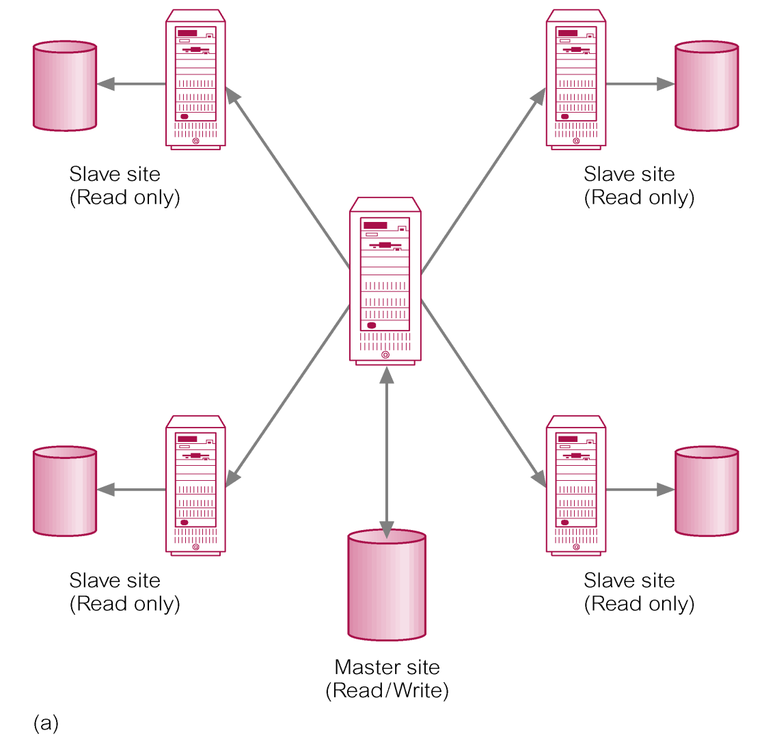
Master/Slave Ownership – Data Dissemination

Slide 62
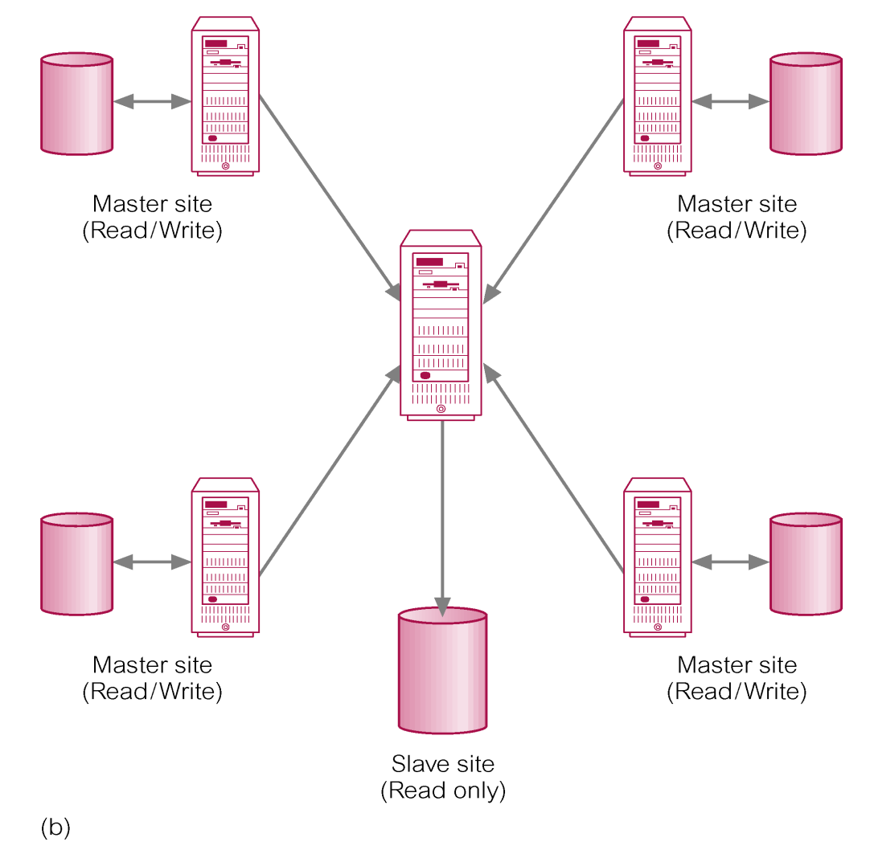
Master/Slave Ownership – Data Consolidation

Slide 63
Workflow Ownership
Avoids update conflicts, while providing more dynamic ownership model.
Allows right to update replicated data to move from site to site.
However, at any one moment, only ever one site that may update that particular data set.
Example is order processing system, which follows series of steps, such as order entry, credit approval, invoicing, shipping, and so on.

Slide 64
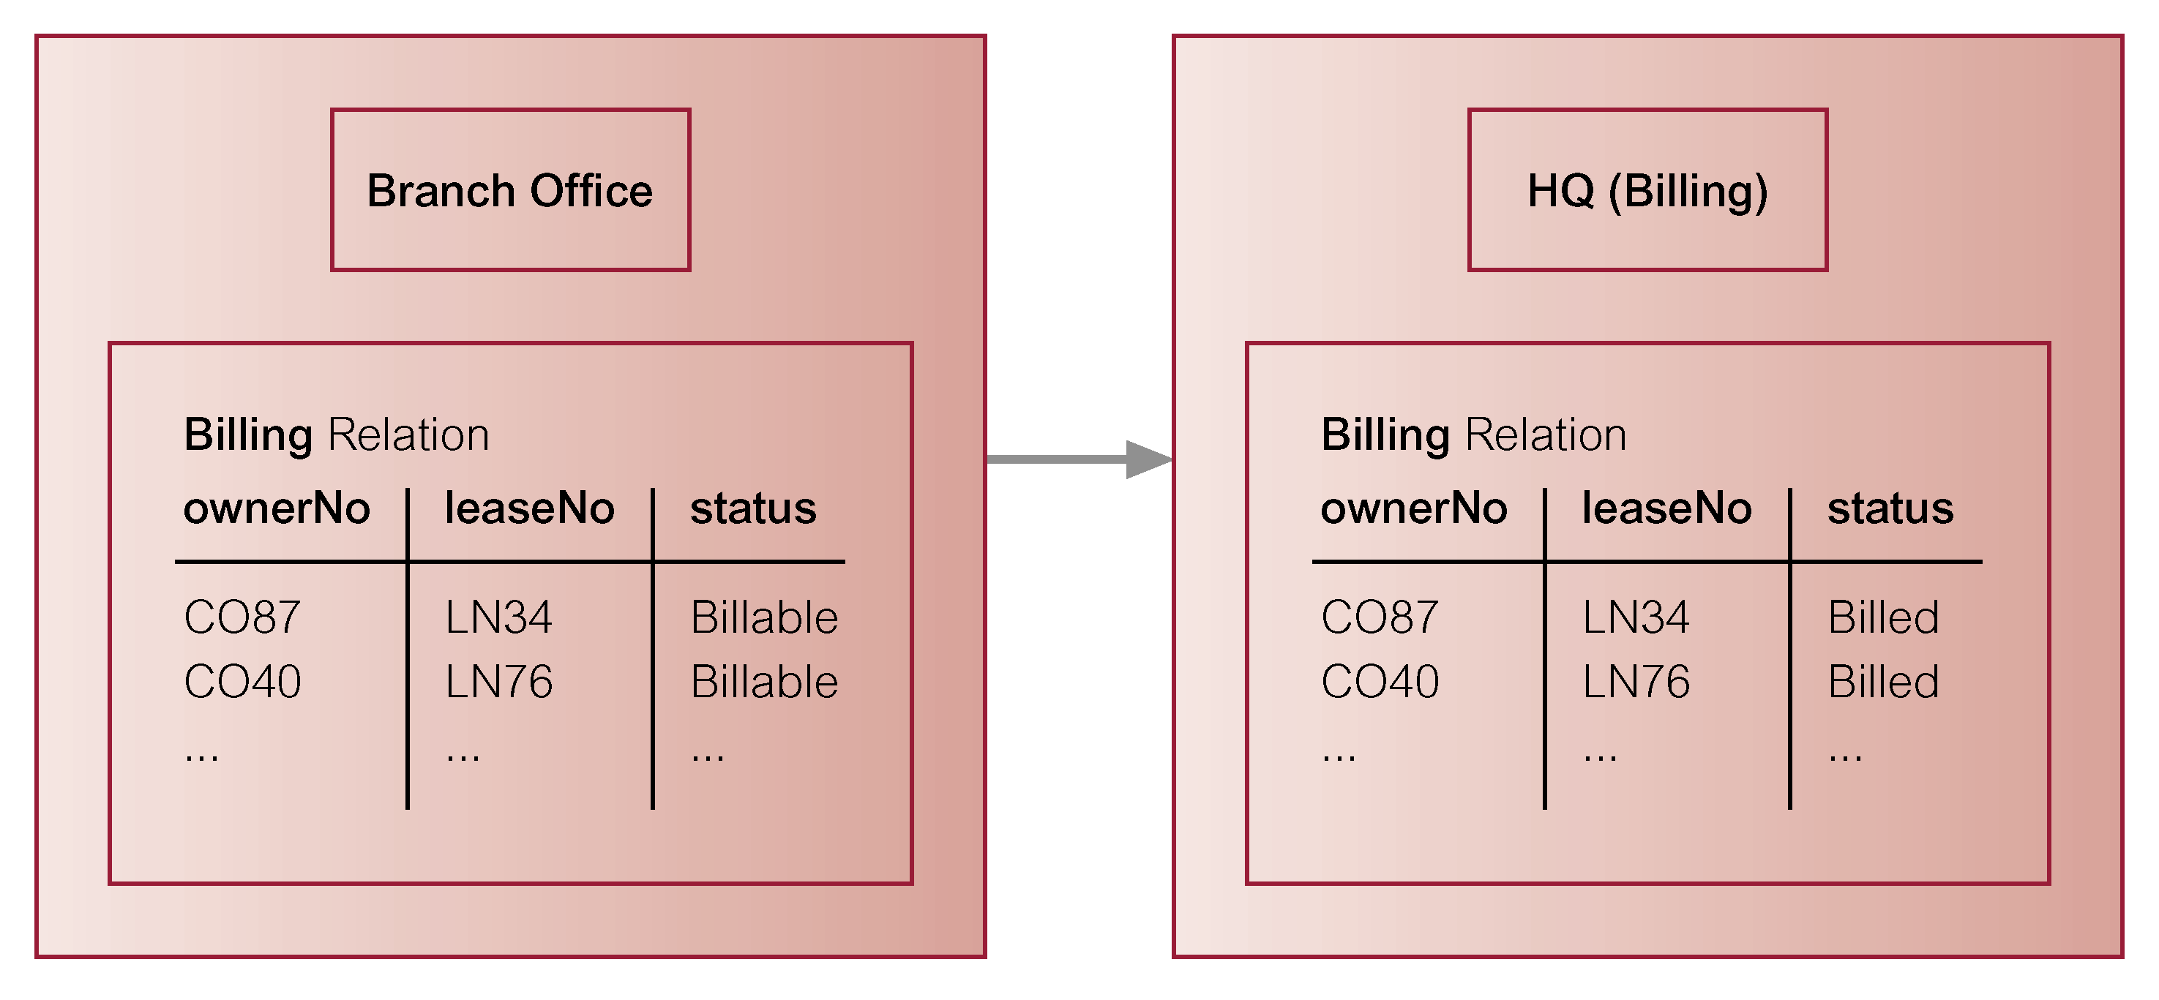
Workflow Ownership

Slide 65
Update-Anywhere Ownership
Creates peer-to-peer environment where multiple sites have equal rights to update replicated data.
Allows local sites to function autonomously, even when other sites are not available.
Shared ownership can lead to conflict scenarios and have to employ methodology for conflict detection and resolution.

Slide 66
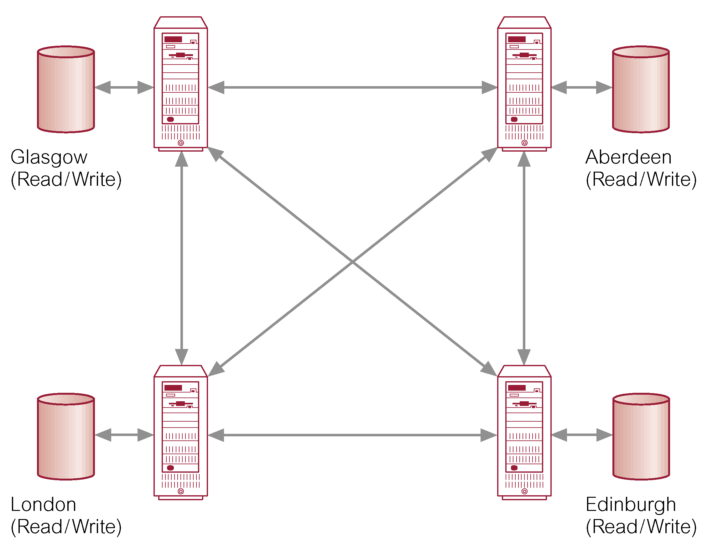
Update-Anywhere Ownership

Slide 67
Non-Transactional versus Transactional Update
Early replication mechanisms were non-transactional.
Data was copied without maintaining atomicity of transaction.
With transactional-based mechanism, structure of original transaction on source database is also maintained at target site.

Slide 68
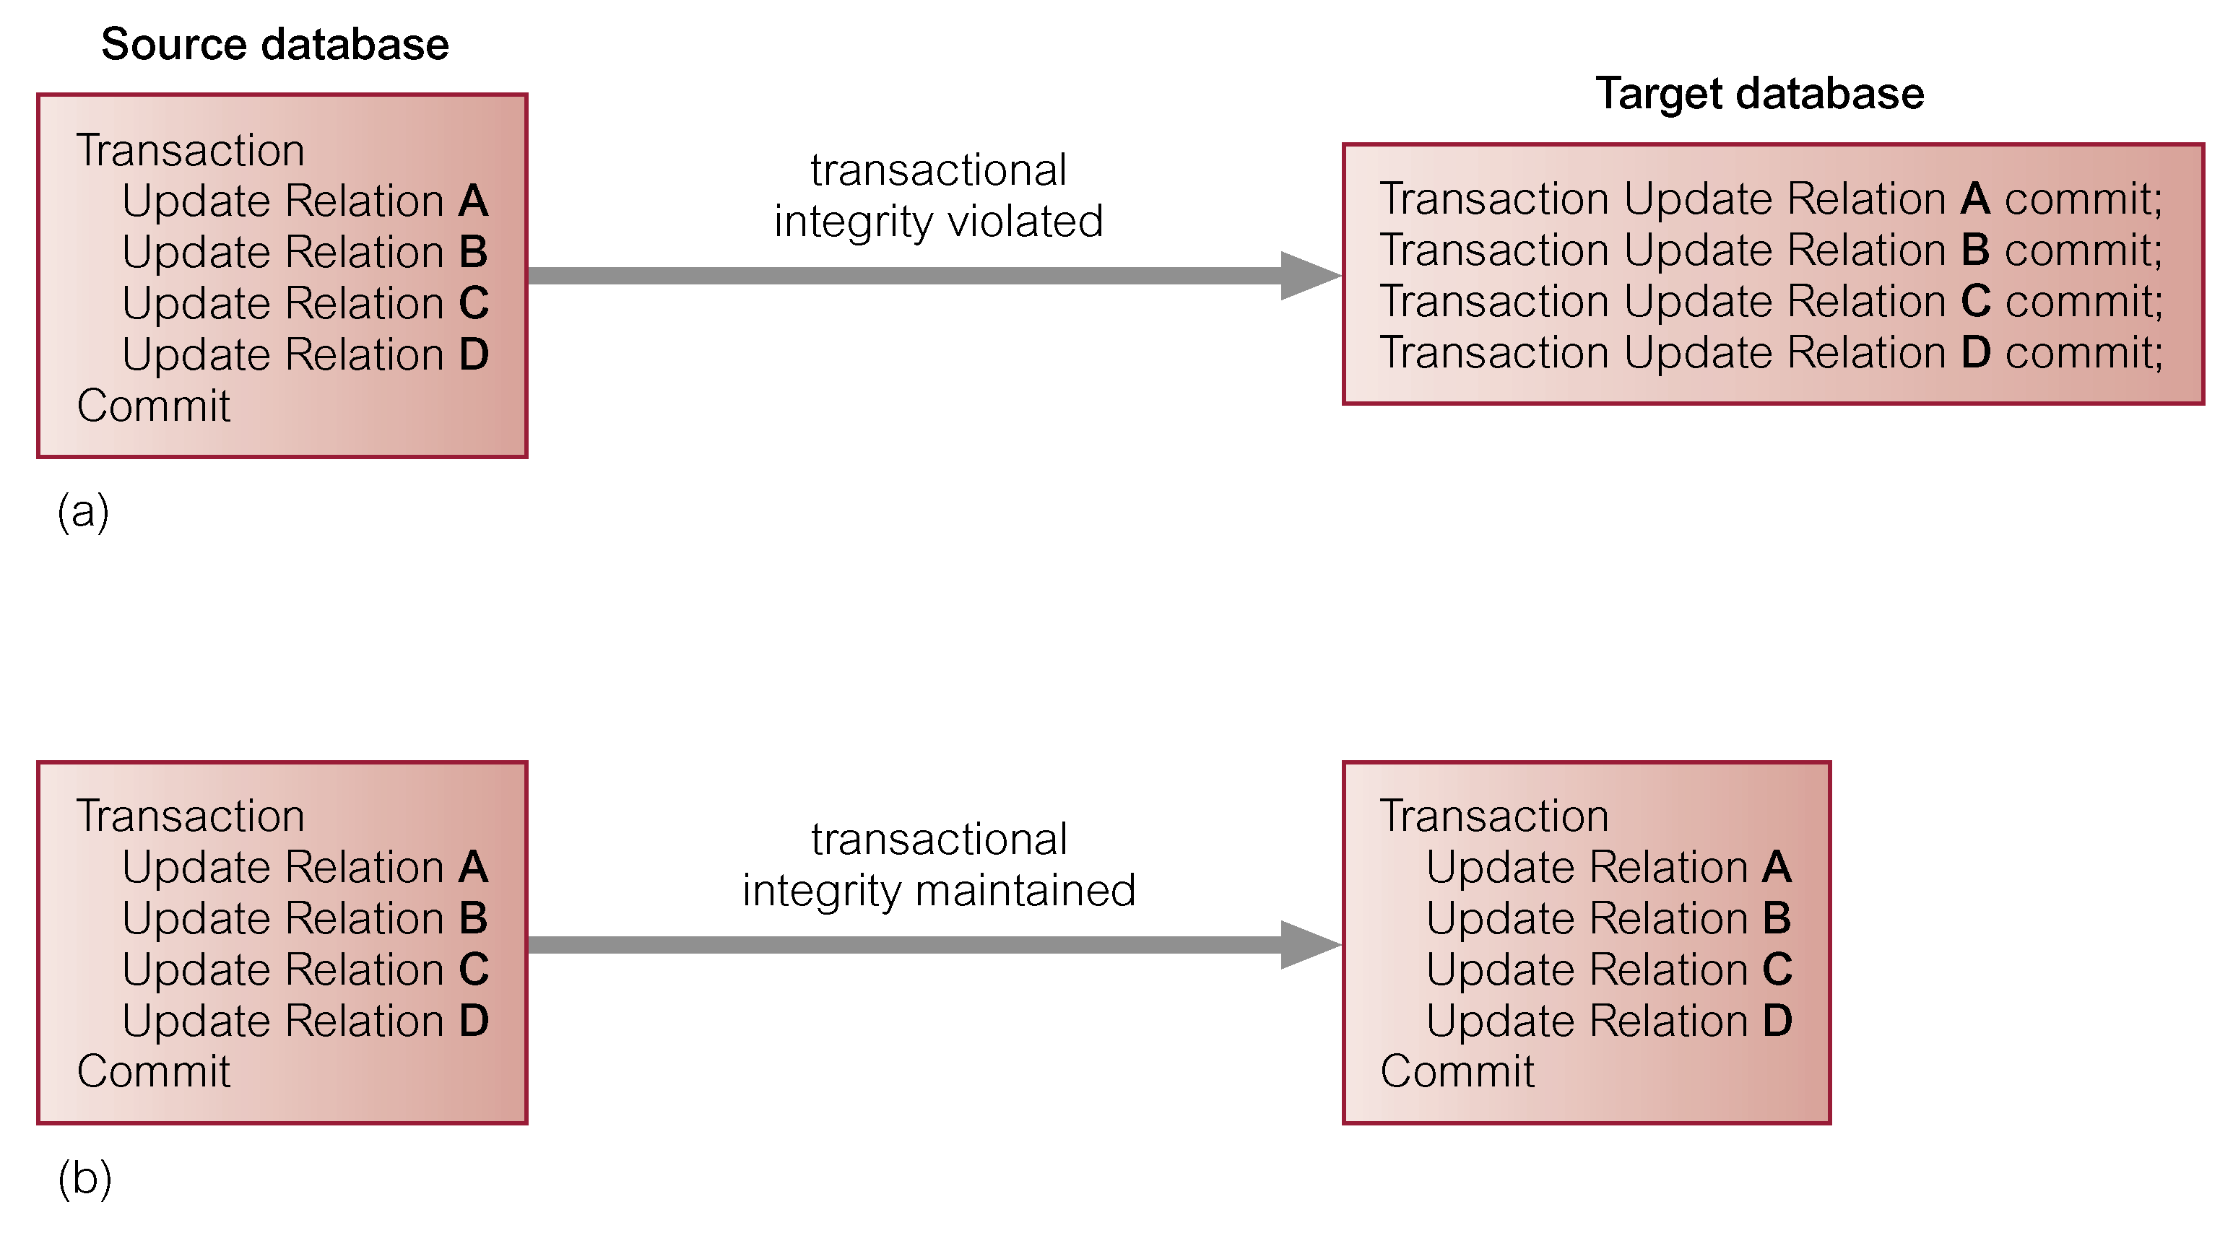
Non-Transactional versus Transactional Update

Slide 69
Snapshots
Allow asynchronous distribution of changes to individual tables, collections of tables, views, or partitions of tables according to pre-defined schedule.
For example, may store Staff relation at one site (master site) and create a snapshot with complete copy of Staff relation at each branch.
Common approach for snapshots uses the recovery log, minimizing the extra overhead to the system.

Slide 70
Snapshots
In some DBMSs, process is part of server, while in others it runs as separate external server.
In event of network or site failure, need queue to hold updates until connection is restored.
To ensure integrity, order of updates must be maintained during delivery.

Slide 71
Database Triggers
Could allow users to build their own replication applications using database triggers.
Users’ responsibility to create code within trigger that will execute whenever appropriate event occurs.

Slide 72
Database Triggers
CREATE TRIGGER StaffAfterInsRow
BEFORE INSERT ON Staff
FOR EACH ROW
BEGIN
INSERT INTO StaffDuplicate@Rentals.Glasgow.North.Com
VALUES (:new.staffNo, :new:fName, :new:lName, :new.position, :new:sex, :new.DOB, :new:salary, :new:branchNo);
END;

Slide 73
Database Triggers - Drawbacks
Management and execution of triggers have a performance overhead.
Burden on application/network if master table updated frequently.
Triggers cannot be scheduled.
Difficult to synchronize replication of multiple related tables.
Activation of triggers cannot be easily undone in event of abort or rollback.

Slide 74
Conflict Detection and Resolution
When multiple sites are allowed to update replicated data, need to detect conflicting updates and restore data consistency.
For a single table, source site could send both old and new values for any rows updated since last refresh.
At target site, replication server can check each row in target database that has also been updated against these values.

Slide 75
Conflict Detection and Resolution
Also want to detect other types of conflict such as violation of referential integrity.
Some of most common mechanisms are:
  Earliest and latest timestamps.
  Site Priority.
  Additive and average updates.
  Minimum and maximum values.
  User-defined.
  Hold for manual resolution.

Slide 76
Distributed Query Optimization
In distributed environment, speed of network has to be considered when comparing strategies.
If know topology is that of WAN, could ignore all costs other than network costs.
LAN typically much faster than WAN, but still slower than disk access.
In both cases, general rule-of-thumb still applies: wish to minimize size of all operands in RA operations, and seek to perform unary operations before binary operations.

Slide 77
Distributed Query Transformation
In QP, represent query as R.A.T. and, using transformation rules, restructure tree into equivalent form that improves processing.
In DQP, need to consider data distribution.
Replace global relations at leaves of tree with their reconstruction algorithms - RA operations that reconstruct global relations from fragments:
  For horizontal fragmentation, reconstruction algorithm is Union;
  For vertical fragmentation, it is Join.

Slide 78
Distributed Query Transformation
Then use reduction techniques to generate simpler and optimized query.
Consider reduction techniques for following types of fragmentation:
  Primary horizontal fragmentation.
  Vertical fragmentation.
  Derived fragmentation.

Slide 79
Reduction for Primary Horizontal Fragmentation
If selection predicate contradicts definition of fragment, this produces empty intermediate relation and operations can be eliminated.
For join, commute join with union.
Then examine each individual join to determine whether there are any useless joins that can be eliminated from result.
A useless join exists if fragment predicates do not overlap.

Slide 80
Example 20.2 Reduction for PHF
SELECT *
FROM Branch b, PropertyForRent p
WHERE b.branchNo = p.branchNo AND p.type = ‘Flat’;
P₁: σ_{branchNo=‘B003’ ∧ type=‘House’} (PropertyForRent)
P₂: σ_{branchNo=‘B003’ ∧ type=‘Flat’} (PropertyForRent)
P₃: σ_{branchNo!=‘B003’} (PropertyForRent)
B₁: σ_{branchNo=‘B003’} (Branch)
B₂: σ_{branchNo!=‘B003’} (Branch)

Slide 81
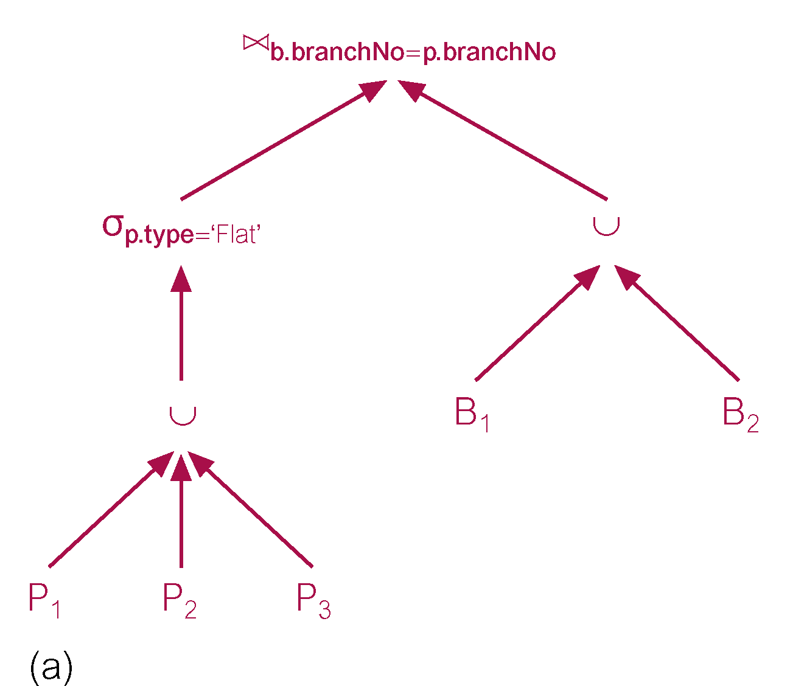
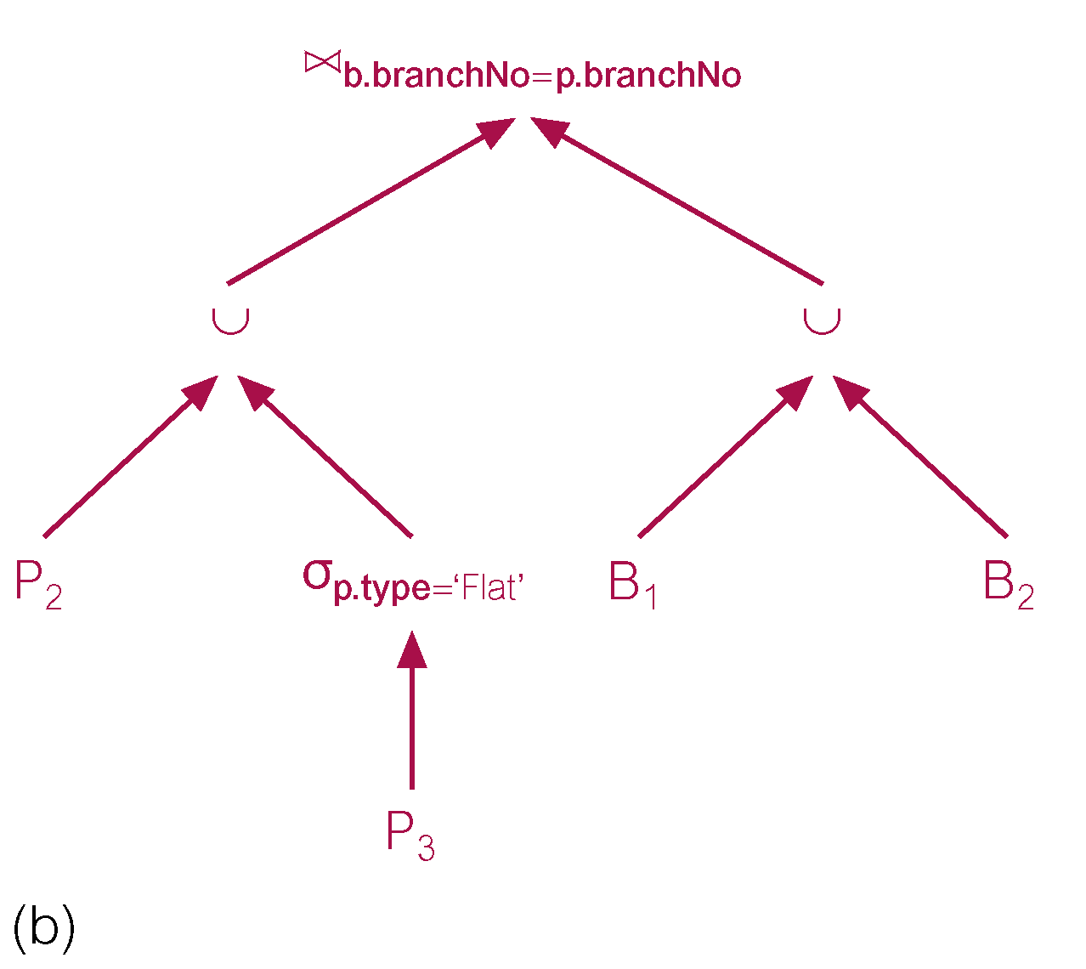
Example 23.2 Reduction for PHF

Slide 82
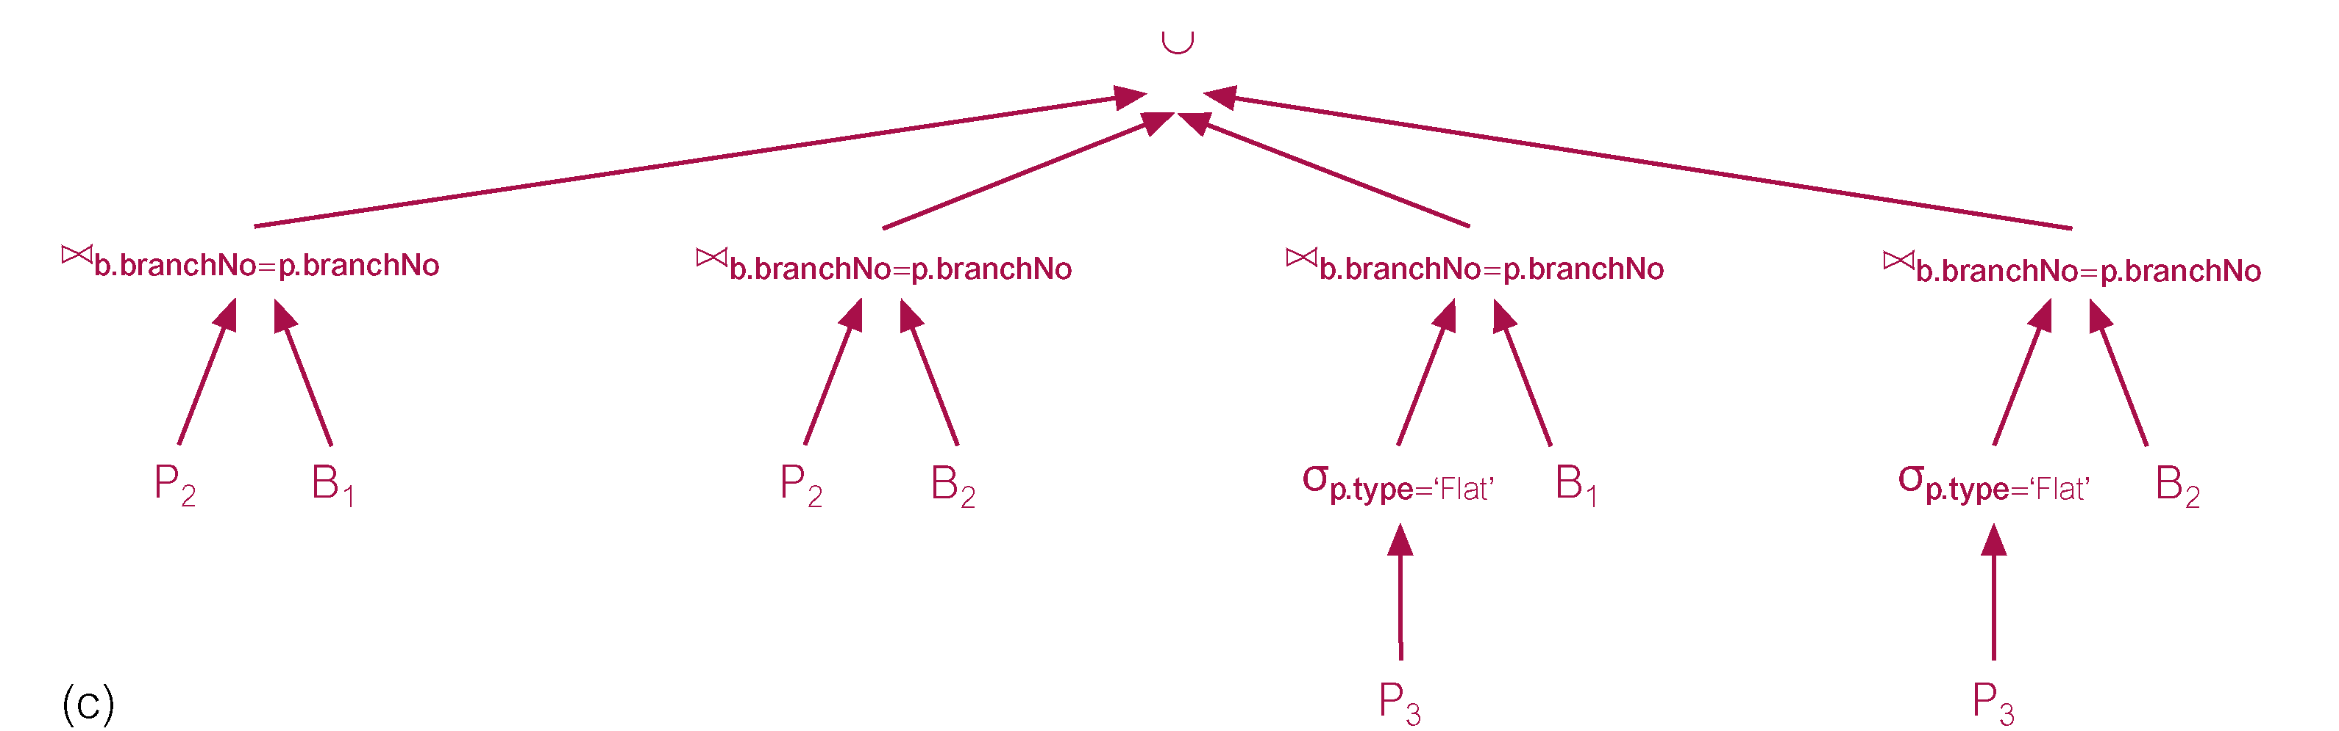
Example 23.2 Reduction for PHF

Slide 83
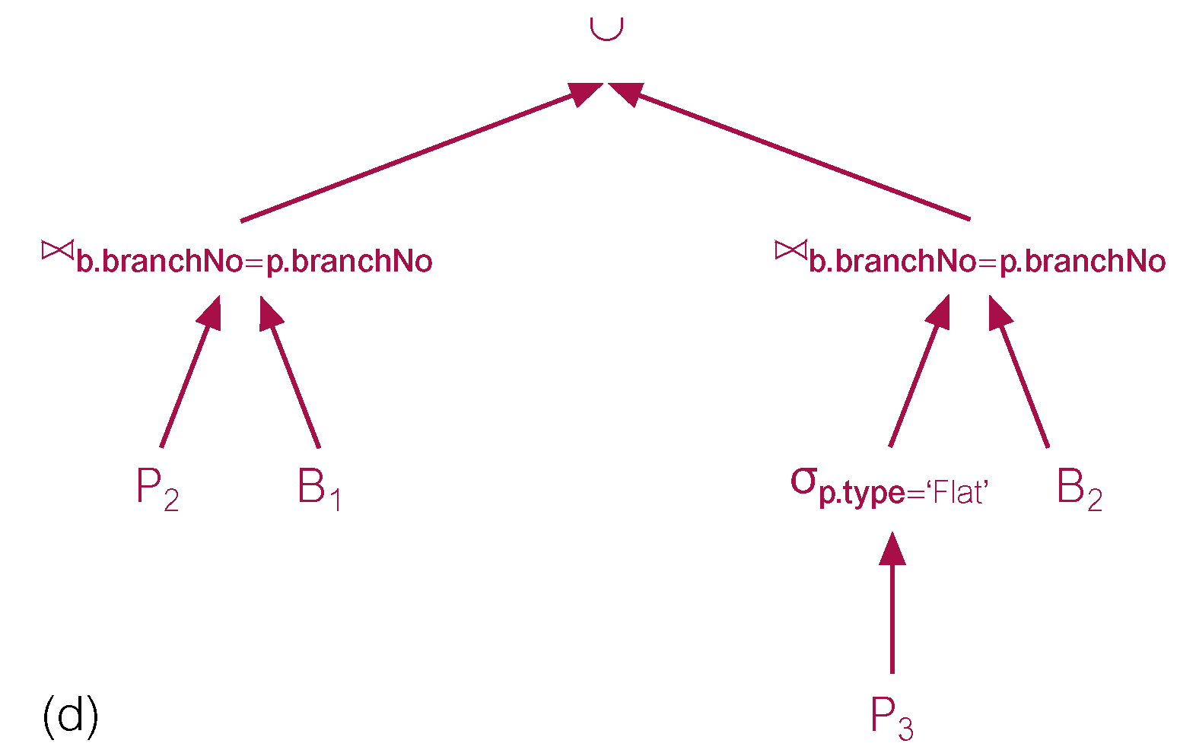
Example 23.2 Reduction for PHF

Slide 84
Reduction for Vertical Fragmentation
Reduction for vertical fragmentation involves removing those vertical fragments that have no attributes in common with projection attributes, except the key of the relation.

Slide 85
Example 23.3 Reduction for Vertical Fragmentation
SELECT fName, lName
FROM Staff;
S₁: Π_{staffNo,} _{position, sex, DOB, salary}(Staff)
S₂: Π_{staffNo,} _{fName, lName, branchNo} (Staff)

Slide 86
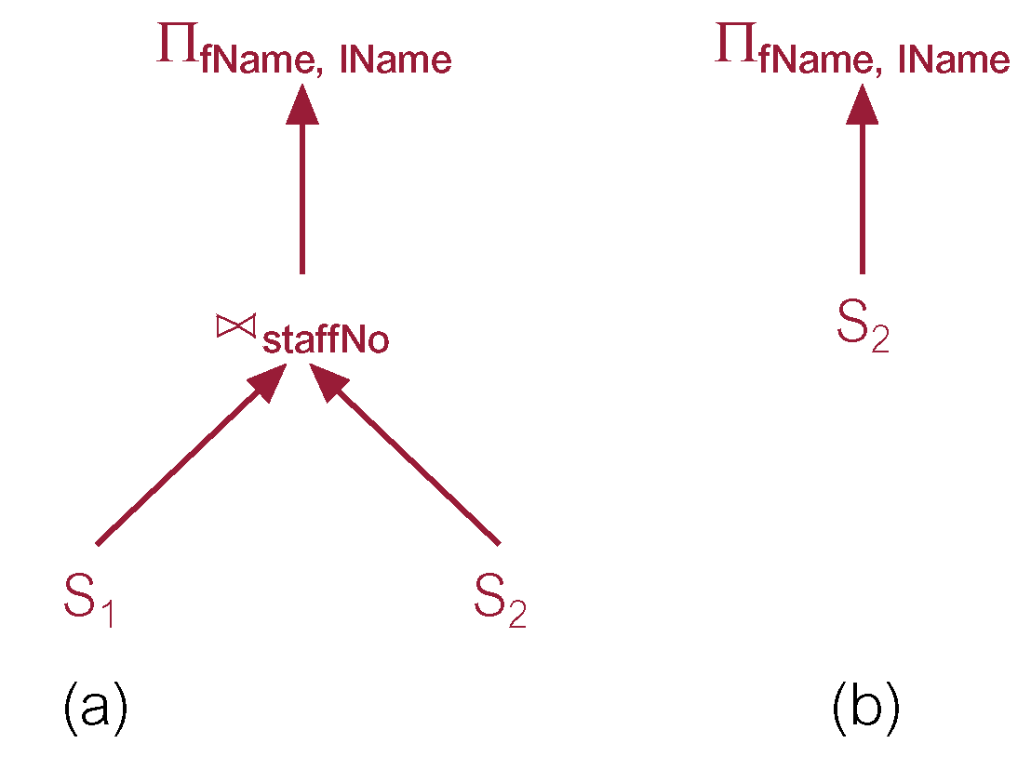
Example 23.3 Reduction for Vertical Fragmentation

Slide 87
Reduction for Derived Fragmentation
Use transformation rule that allows join and union to be commuted.
Using knowledge that fragmentation for one relation is based on the other and, in commuting, some of the partial joins should be redundant.

Slide 88
Example 23.4 Reduction for Derived Fragmentation
  SELECT *
  FROM Branch b, Client c
  WHERE b.branchNo = c.branchNo AND
  b.branchNo = ‘B003’;
B₁ = σ_{branchNo=‘B003’} (Branch)
B₂ = σ_{branchNo!=‘B003’} (Branch)
C_{i} = Client _{branchNo} B_{i} i = 1, 2

Slide 89
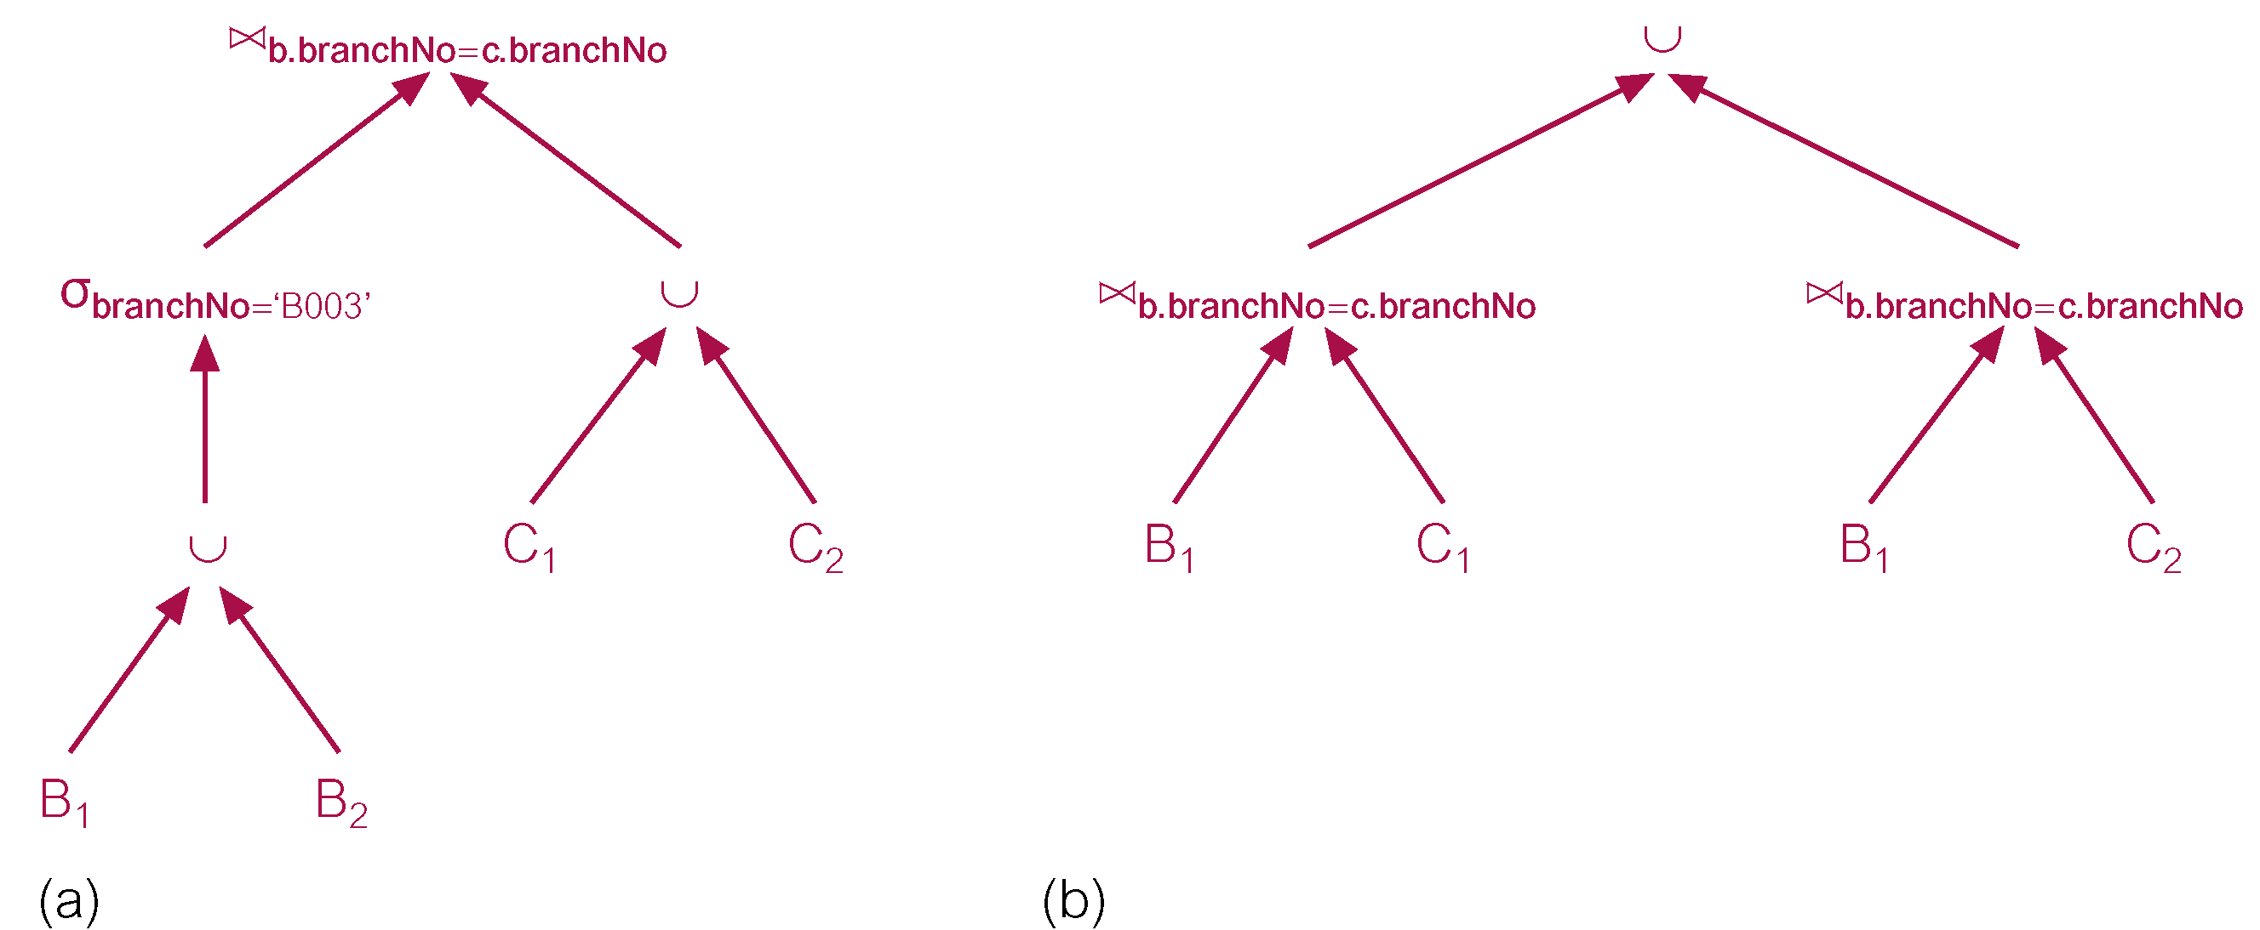
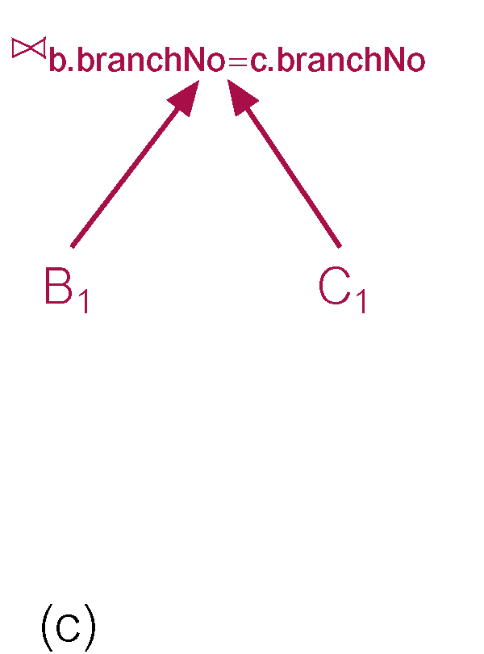
Example 23.4 Reduction for Derived Fragmentation

Slide 90
Mobile Databases
Increasing demands on mobile computing to provide types of support required by growing number of mobile workers.
Work as if in the office but in reality working from remote locations.
‘Office’ may accompany remote worker in form of laptop, PDA (Personal Digital Assistant), or other Internet access device.

Slide 91
Mobile Database
Database that is portable and physically separate from a centralized database server but is capable of communicating with server from remote sites allowing the sharing of corporate data.

Slide 92
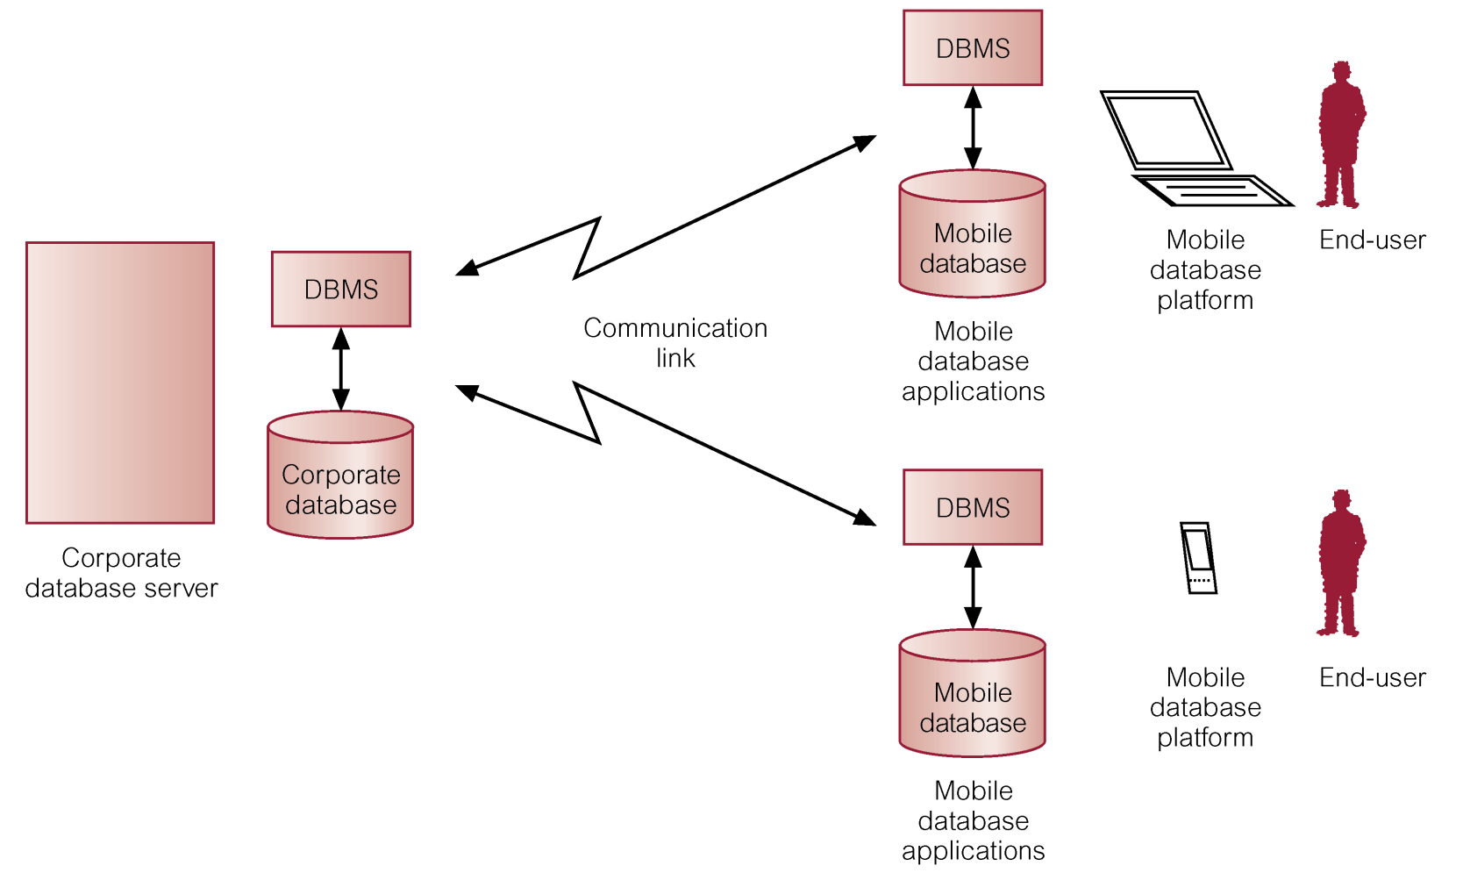
Mobile DBMS

Slide 93
Mobile DBMS
Functionality required of mobile DBMSs includes ability to:
  communicate with centralized database server through modes such as wireless or Internet access;
  replicate data on centralized database server and mobile device;
  synchronize data on centralized database server and mobile device;
  capture data from various sources such as Internet;
  manage/analyze data on the mobile device;
  create customized mobile applications.

Slide 94
Oracle’s DDBMS Functionality
Look at:
  connectivity;
  global database names;
  database links;
  referential integrity;
  heterogeneous distributed databases;
  distributed query optimization.

Slide 95
Connectivity
Net8 is Oracle’s data access application to support communication between clients and servers.
Net8 enables both client-server and server-server communications across any network, supporting both distributed processing and distributed DBMS capability.
Even if a process is running on same machine as database instance, Net8 still required to establish its database connection.
Net8 also responsible for translating any differences in character sets or data representations that may exist at operating system level.

Slide 96
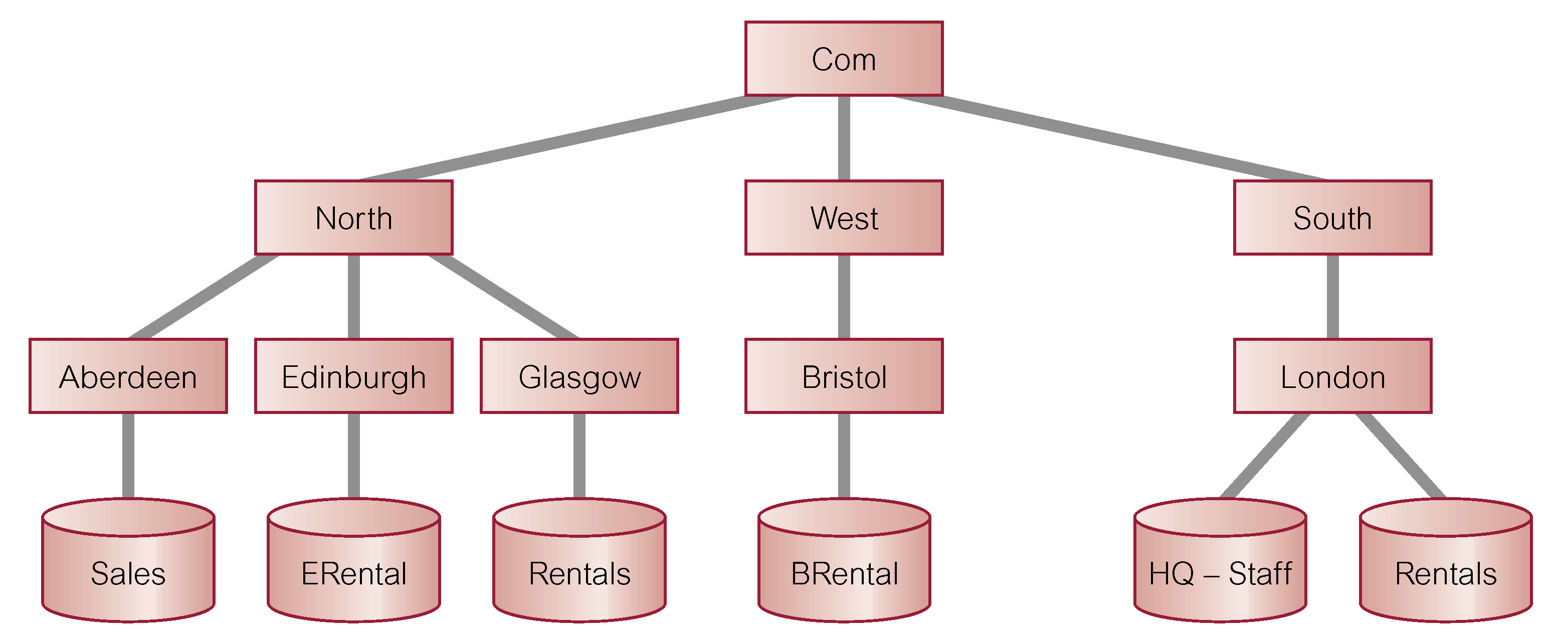
Global Database Names
Each distributed database is given a global database name, distinct from all databases in system. Name formed by prefixing database’s network domain name with local database name. Domain name must follow standard Internet conventions.

Slide 97
Database Links
DDBs in Oracle are built on database links, which define communication path from one Oracle database to another.
Purpose of database links is to make remote data available for queries and updates, essentially acting as a type of stored login to the remote database.
For example:
  CREATE PUBLIC DATABASE LINK
  RENTALS.GLASGOW.NORTH.COM;

Slide 98
Database Links
Once database link has been created, it can be used to refer to tables and views on the remote database by appending @databaselink to table or view name.
For example:
  SELECT *
  FROM Staff@RENTALS.GLASGOW.NORTH.COM;

Slide 99
Oracle Replication
Oracle Advanced Replication supports both synchronous and asynchronous replication.
It allows tables and supporting objects, such as views, triggers, and indexes, to be replicated.
In Standard Edition, there can be only one master site that can replicate changes to other slave sites.
In Enterprise Edition, there can be multiple master sites and updates can occur at any of these sites.

Slide 100
Types of Replication
(1) Read-only snapshots (or materialized views). A master table is copied to one or more remote databases. Changes in the master table are reflected in the snapshot tables whenever snapshot refreshes, as determined by the snapshot site.
(2) Updateable snapshots. Similar to read-only snapshots except that the snapshot sites are able to modify data and send their changes back to the master site. Again, snapshot site determines frequency of refreshes and frequency with which updates are sent back to the master site.

Slide 101
Types of Replication
(3) Multimaster replication. Table is copied to one or more remote databases, where table can be updated. Modifications are pushed to the other database at an interval set by DBA for each replication group.
(4) Procedural replication. A call to a packaged procedure or function is replicated to one or more databases.

Slide 102
Replication Groups
Used to simplify administration.
Typically, replication groups are created to organize the schema objects that are required by a particular application.
Replication group objects can come from several schemas and a schema can contain objects from different replication groups.
However, a replication object can be a member of only one group.

Slide 103
Replication Groups
Master site maintains complete copy of all objects in a replication group. All master sites communicate directly with one another to propagate updates to data in a replication (master) group. Each corresponding master group at each site must contain the same set of replication objects, based on a single master definition site.
Snapshot site supports read-only snapshots and updateable snapshots of table data at an associated master site. Snapshots are updated by one or more master tables via individual batch updates, known as refreshes, from a single master site.

Slide 104
Refresh Types
COMPLETE: the server that manages snapshot executes snapshot’s defining query. Result set replaces existing snapshot data to refresh the snapshot.
FAST: the server that manages the snapshot first identifies the changes that occurred in the master table since the most recent refresh of the snapshot and then applies them to the snapshot.
FORCE: the server that manages the snapshot first tries to perform a fast refresh. If a fast refresh is not possible, then Oracle performs a complete refresh.

Slide 105
Creating Snapshots
CREATE SNAPSHOT Staff
REFRESH FAST
START WITH sysdate NEXT sysdate + 7
WITH PRIMARY KEY
AS SELECT *
FROM Staff@RENTALS.LONDON.SOUTH.COM WHERE branchNo = ‘B003’;

